Slide 1
UI/UX Design
Lesson10: Case Practice & Final Project
Presented by Krystal Educational Platform

Slide 2
Lesson Outline
Learn about UI/UX design detail
Understand the detailed UI/UX design process
Follow the step the finish the UI/UX Design process
Think about the UI/UX design final project

Slide 3
Contents
10.1
Case Practice (II)
10.2
Case Practice (III)
10.3
Final Project

Slide 4
Case Practice (II)
10.1

Slide 5
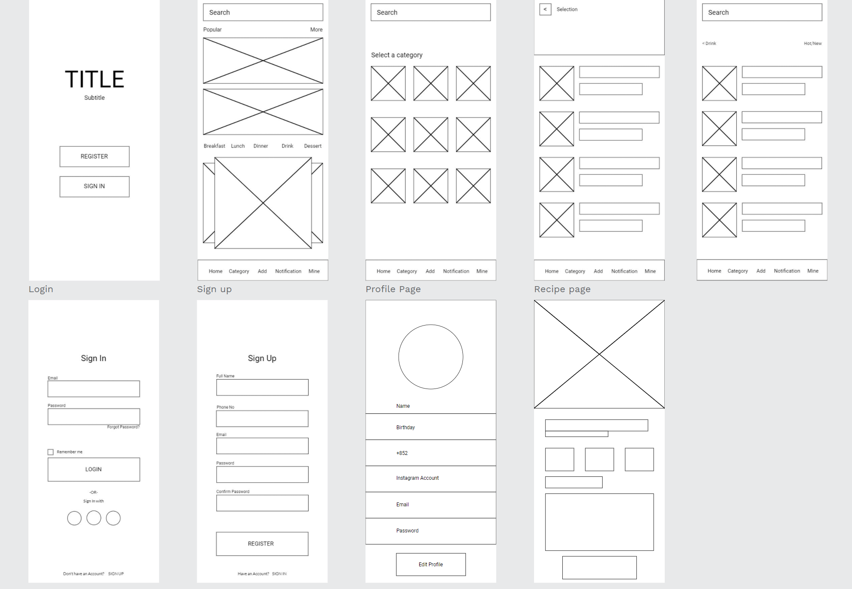
10.1 Case Practice (II)
Step1. Now that we have the basic wireframe, it's time to move on to the UI design.
students proceed to the UI process according to the materials given by the teacher and follow the steps.

Slide 6
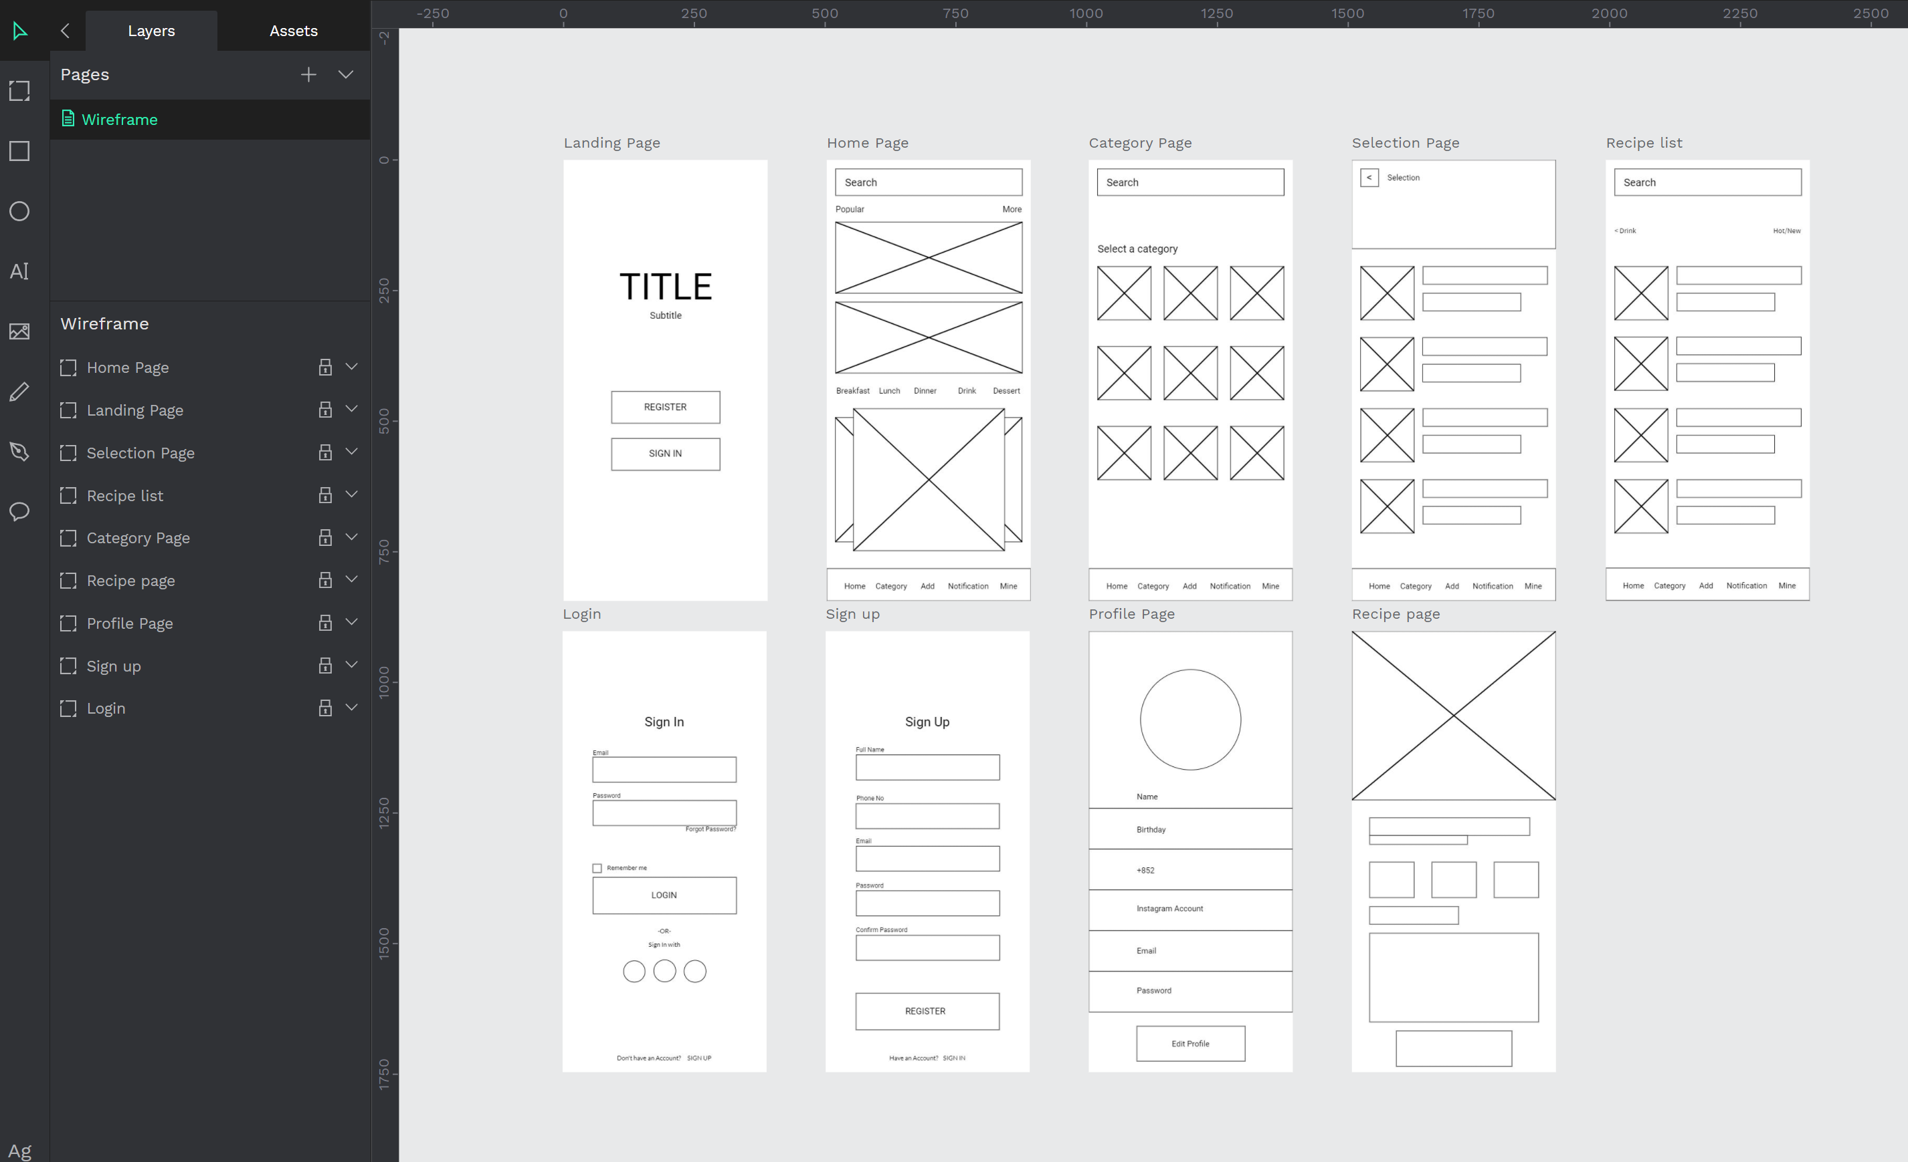
10.1 Case Practice (II)
Step2. Before we start the recipe app UI design, we need to do some steps.
You can see that the wireframe page already has a lot of layers. If you continue to create on the same page, the layers will become very confusing, so we have to create a new page.

Slide 7
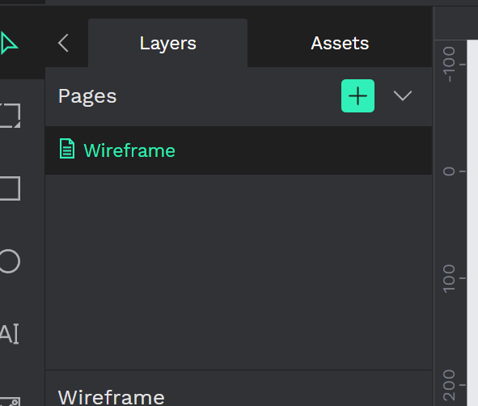
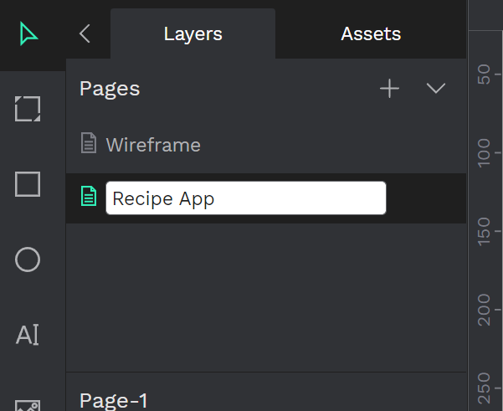
10.1 Case Practice (II)
Step3. Press the + button, it will create a new page, rename the page name to recipe app or recipe app UI design.

Slide 8
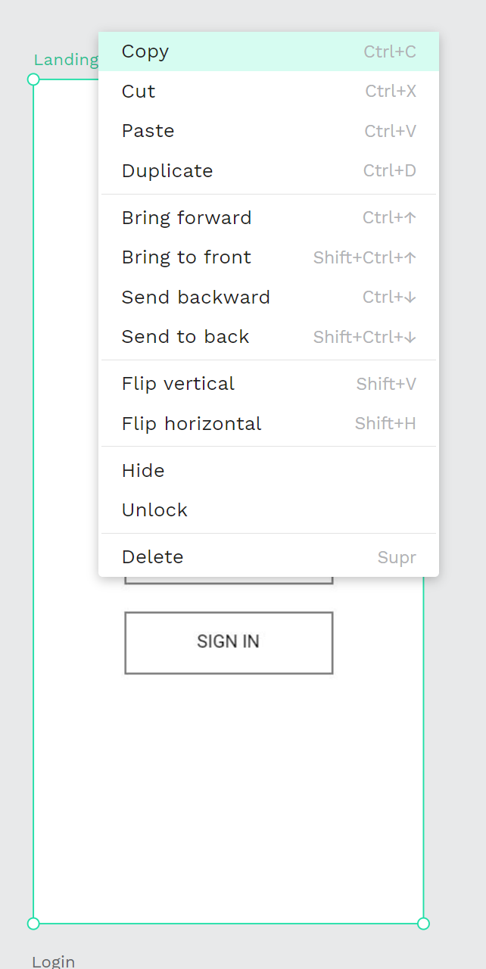
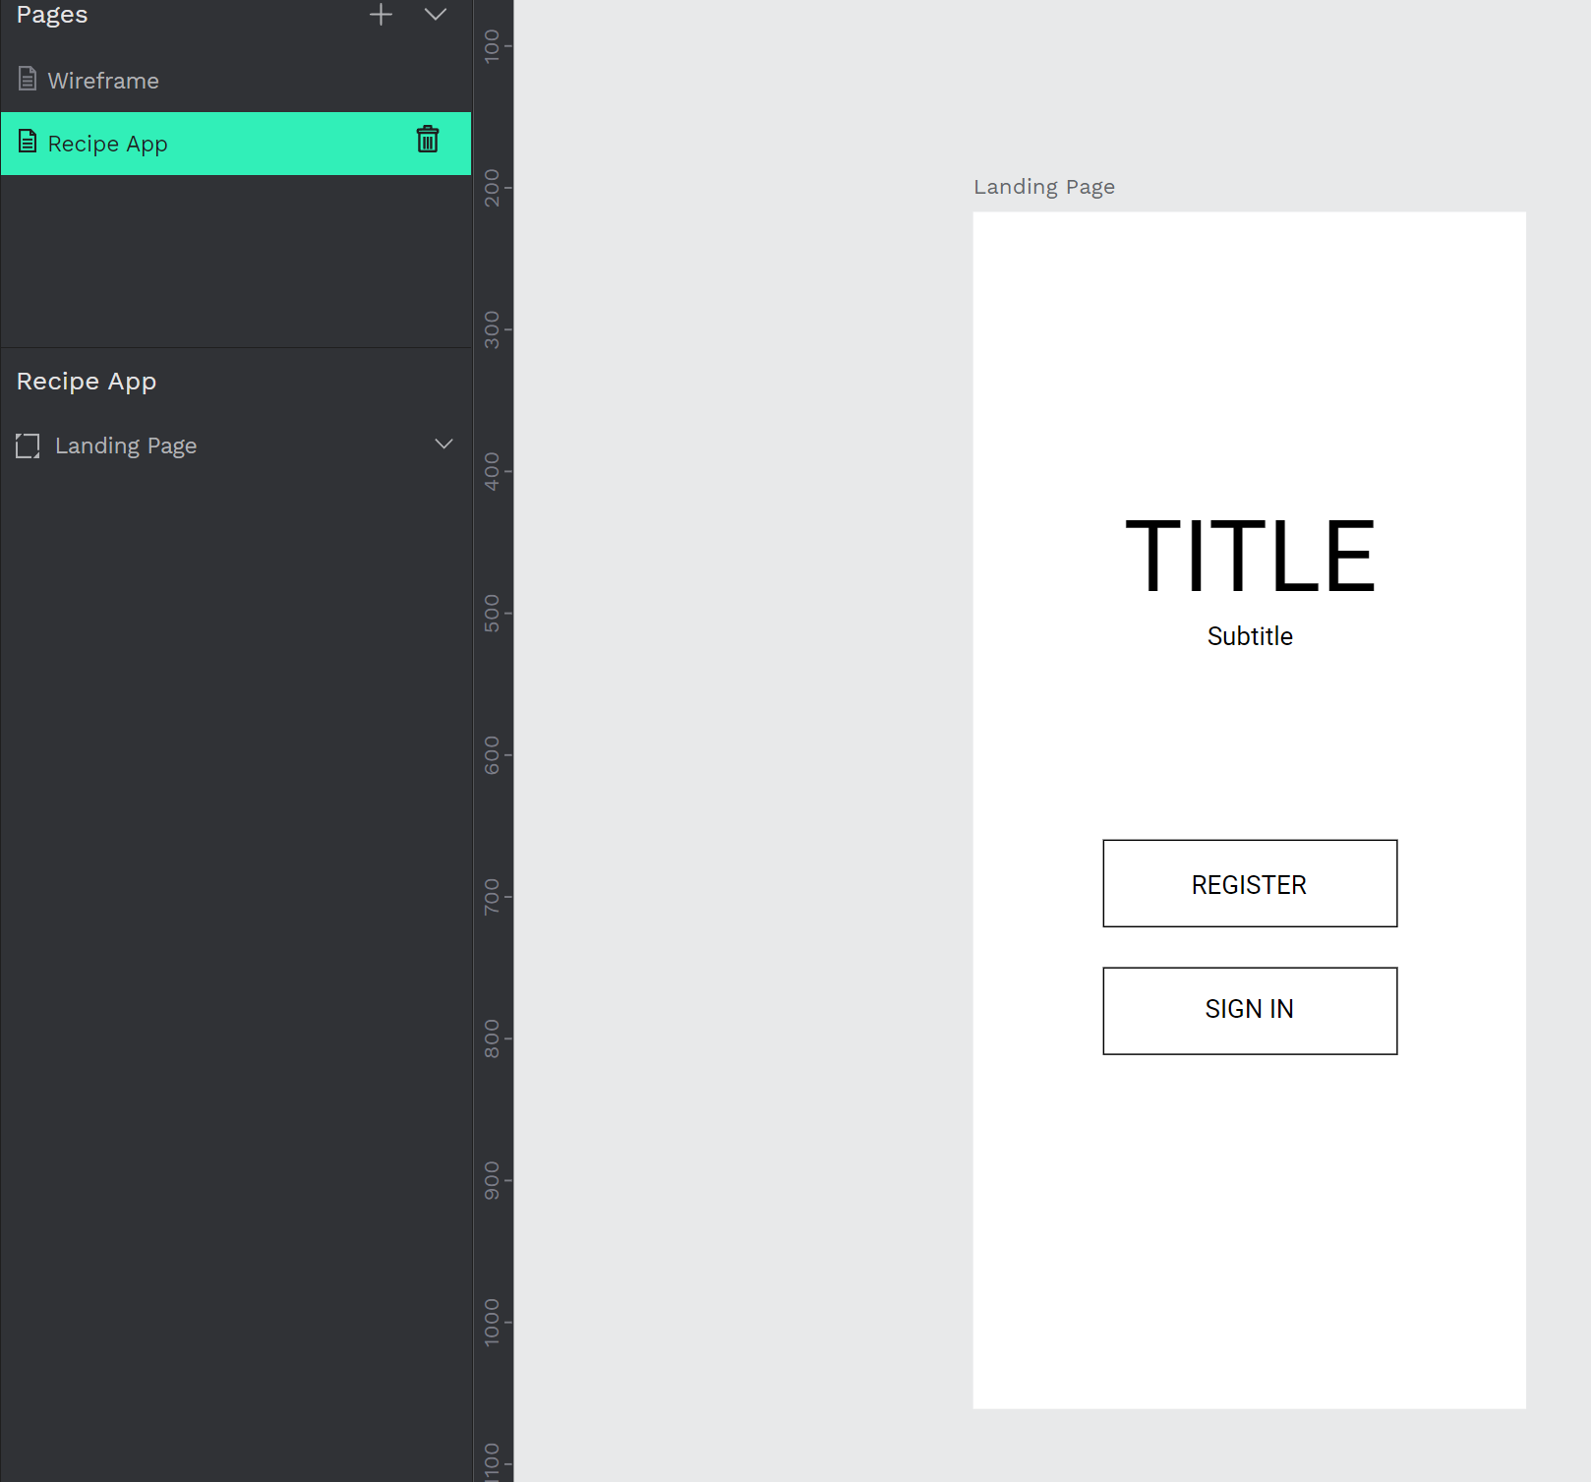
10.1 Case Practice (II)
Step4. Select the landing page, right-click or CTRL+C to copy it, go back to the recipe app page, paste the landing page, if you have blocked the landing page, remember to unblock it.

Slide 9
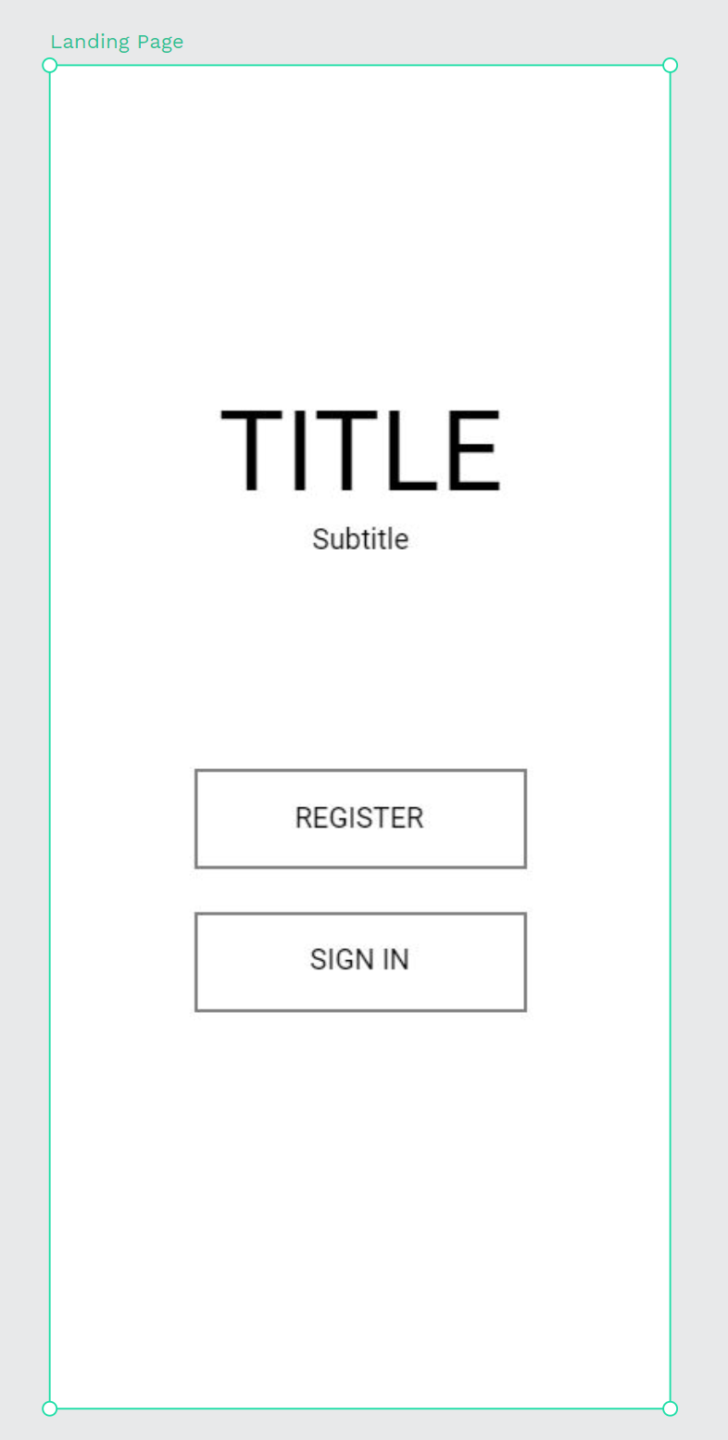
10.1 Case Practice (II)
Step5. Now we have a brand new landing page, we first do the UI design of the landing page, and so on for UI design.

Slide 10
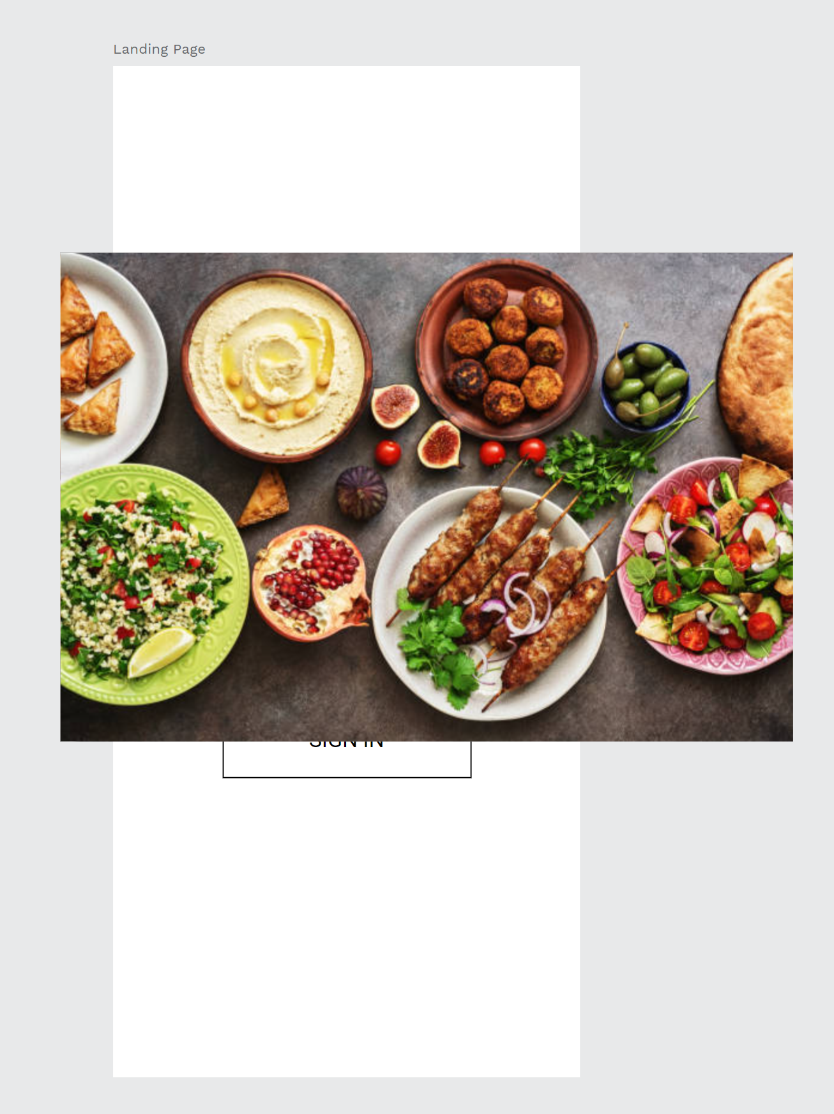
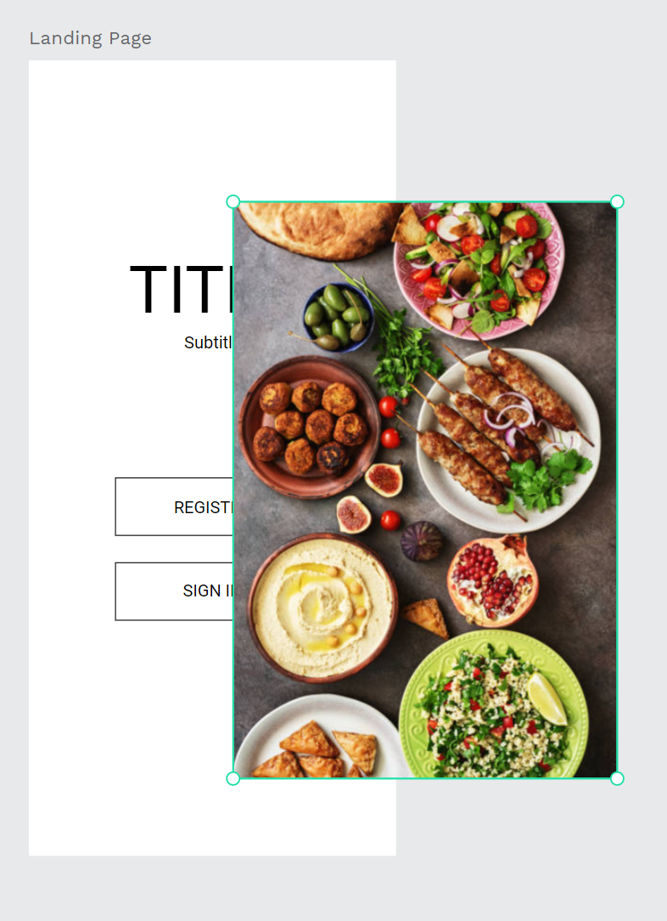
10.1 Case Practice (II)
Step6. First, we input the food picture, this image is for the landing page background photo.
Select the food picture, change the rotation from 0 dg to 270 dg, to make the image straighten.

Slide 11
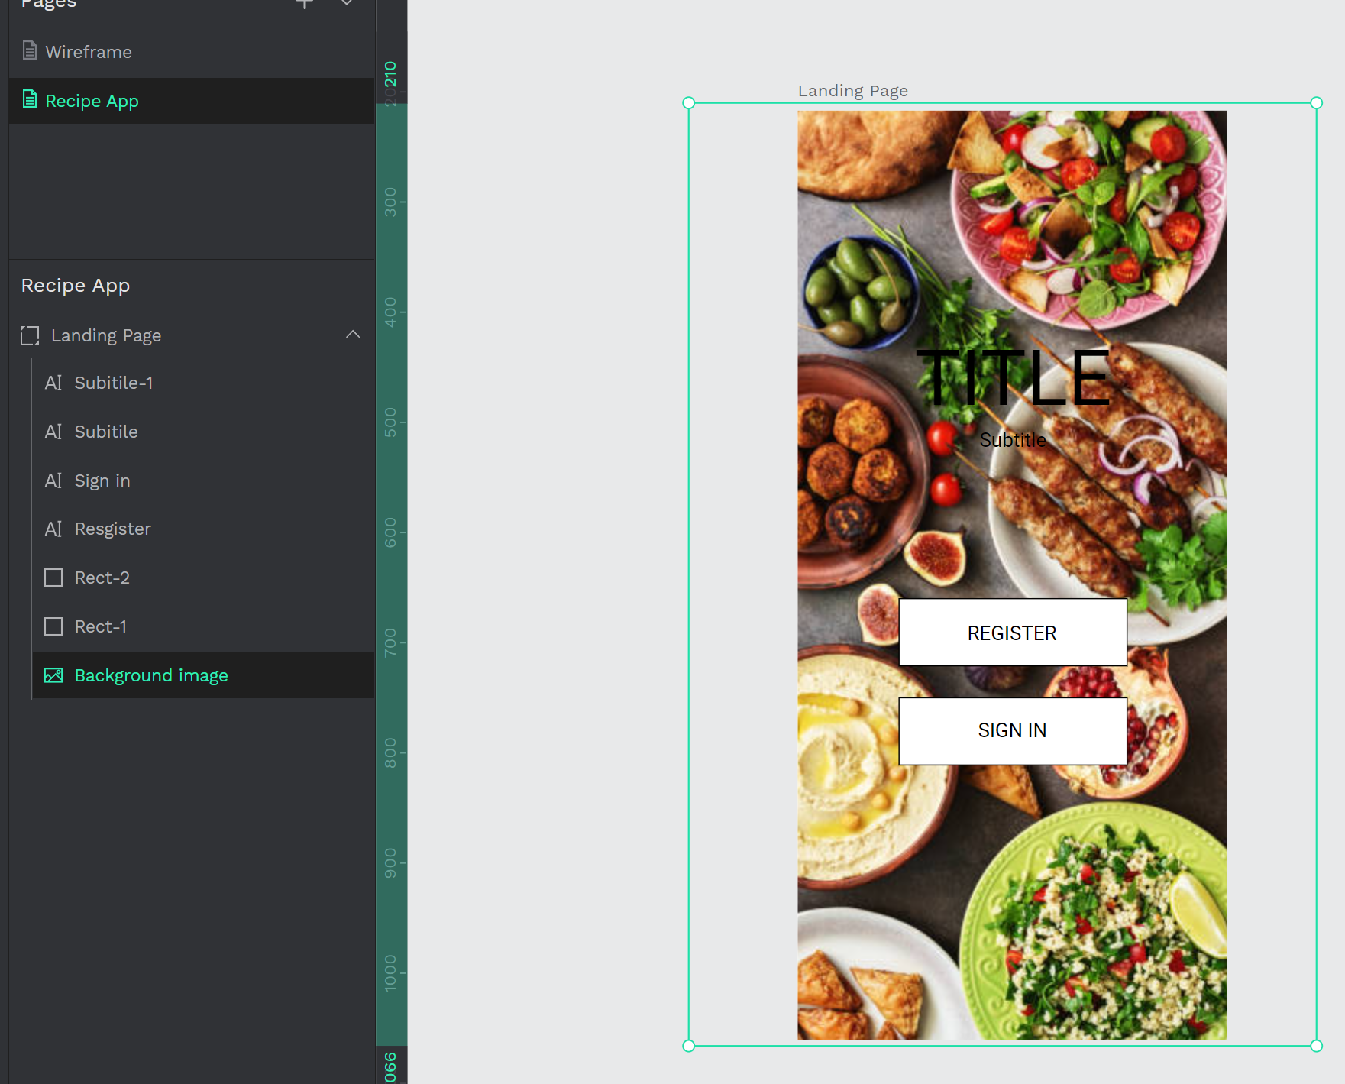
10.1 Case Practice (II)
Step7. Scale the image biggest, covering the entire artboard, Drag the image to the middle of the artboard, you can slowly adjust the position until you feel it is suitable.
Rename the image to the background image, and drag the image to the bottom position of the layer.

Slide 12
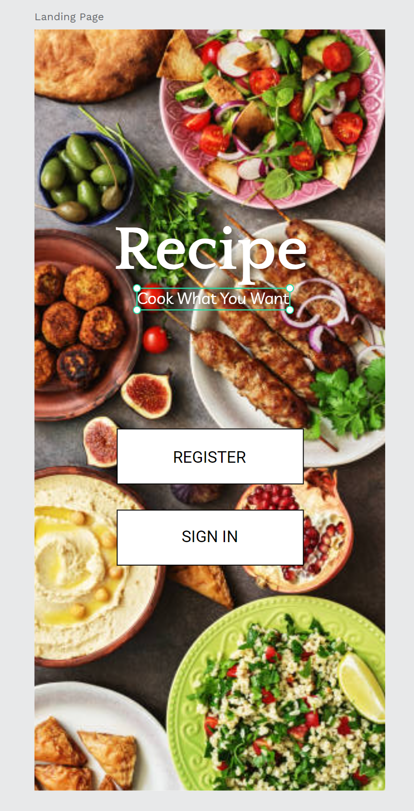
10.1 Case Practice (II)
Step8. Change the title and subtitle text to the recipe and a short sentence.
Change the text color to white color (ffffff), and the font, the font can be chosen by yourself, but should be fit to the recipe style, give the text shadow to make the text more protrude.

Slide 13
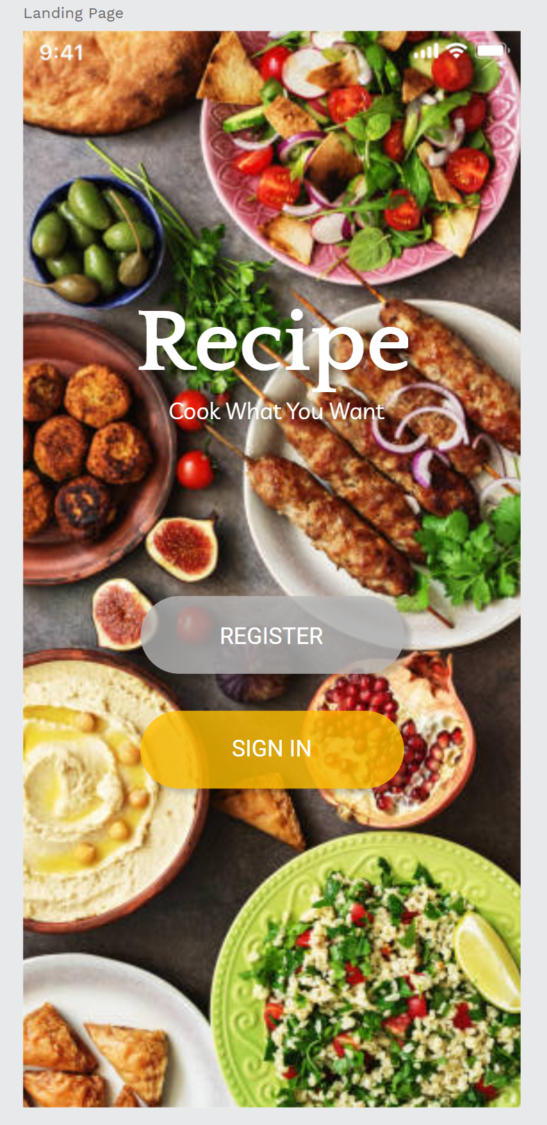
10.1 Case Practice (II)
Step9. delete the button stroke effect first.
Change the Register button to grey color, Sign in button to orange color and the opacity 100% to 70- 80%, select single corners 50, 50, 50, 50, add the shadow effect, and change the text color the white color.

Slide 14
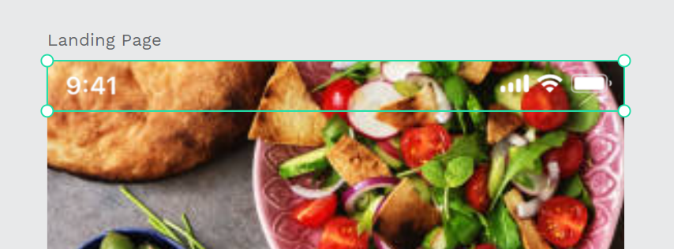
10.1 Case Practice (II)
Step10. Adding the iPhone UI material image, drag the image to the top position.
Now we have the complete landing page UI prototype page.

Slide 15
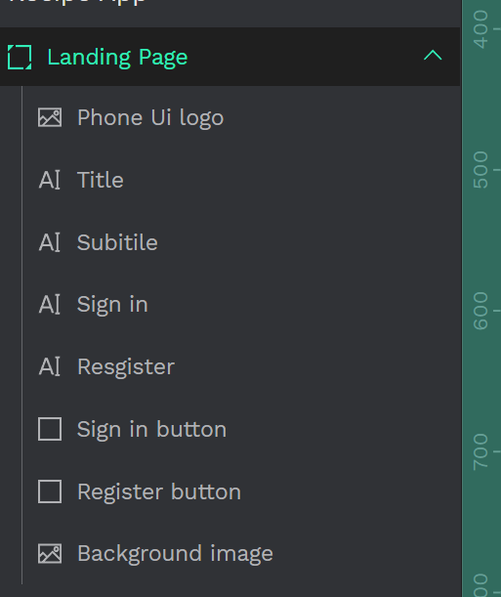
10.1 Case Practice (II)
Step11. Remember to change every layer’s name to the correct name, this is help us reduce time wasted when looking for layers.
Arrange the order of different layers to prevent mistakes.

Slide 16
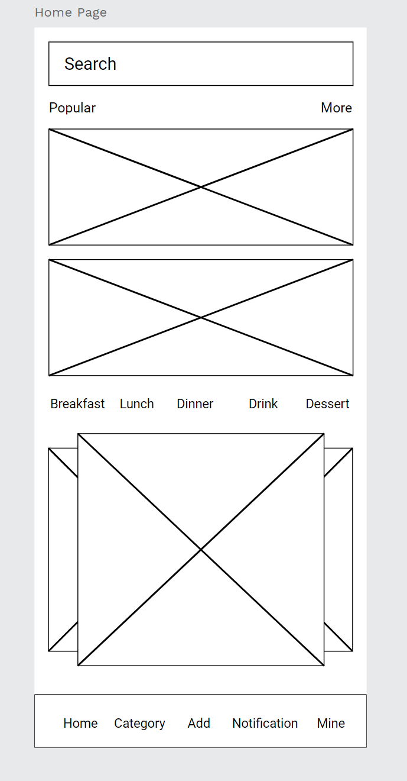
10.1 Case Practice (II)
Step12. Copy the home page artboard to the recipe app page for the UI design.
This page will use a lot of logos and images, please use the materials given by the teacher to design the UI.

Slide 17
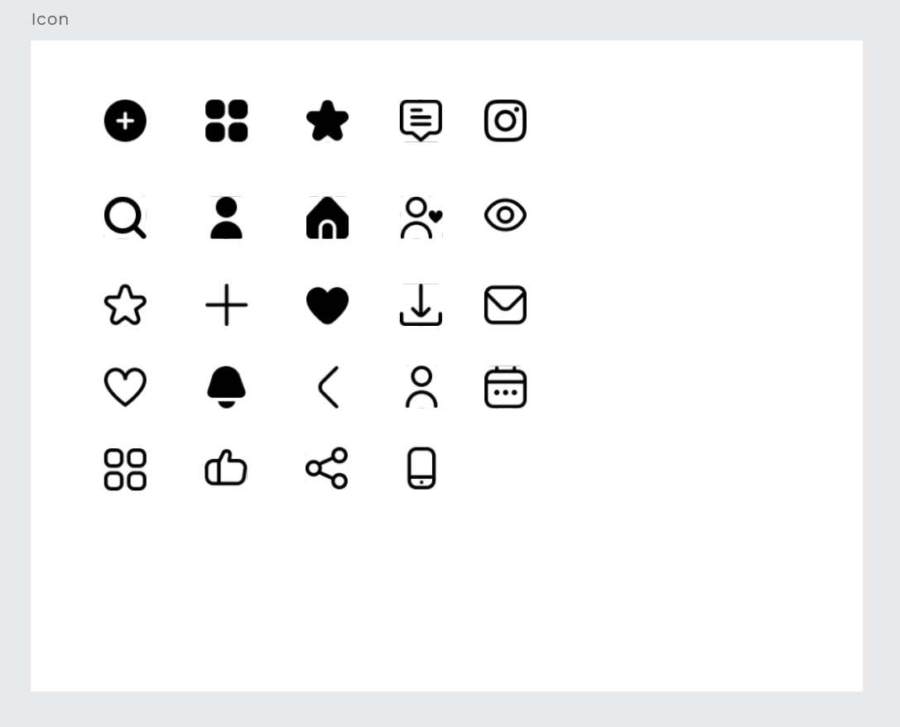
10.1 Case Practice (II)
Step13. Create a new artboard and rename it to the icon. These icons are downloaded from flaticon, you can find a lot of different style icons on this website.
after we input the icon in this artboard, change the icon size to 30 W, 30 H in design properties, after dragging each icon out and arranging the position.

Slide 18
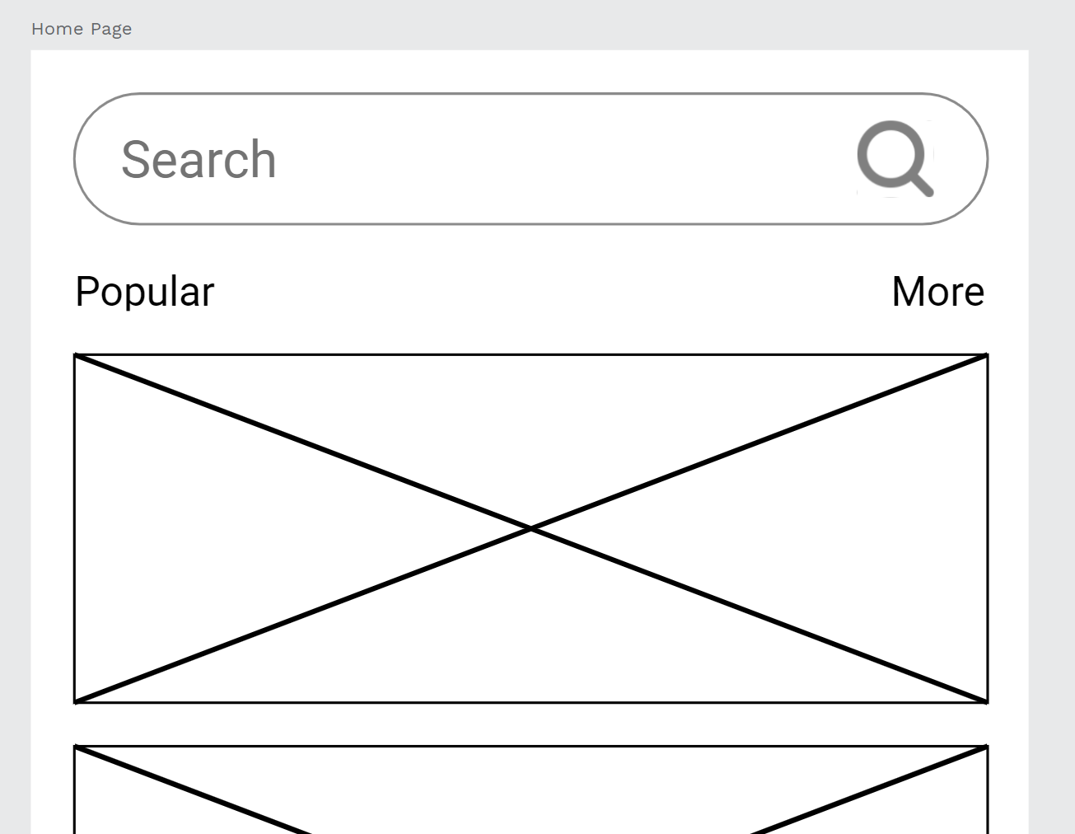
10.1 Case Practice (II)
Step14. We change the search bar first, change the search bar to single corners 40, 40, 40, 40, keep the stroke effect and choose the grey color to make it more transparent, change the search text to grey color too, last add the magnifier icon from the icon artboard and put in into right side.

Slide 19
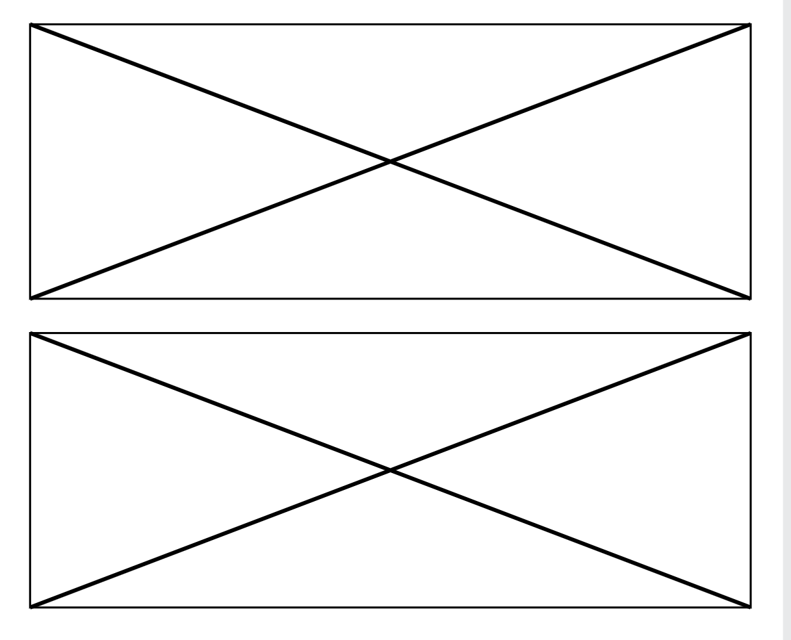
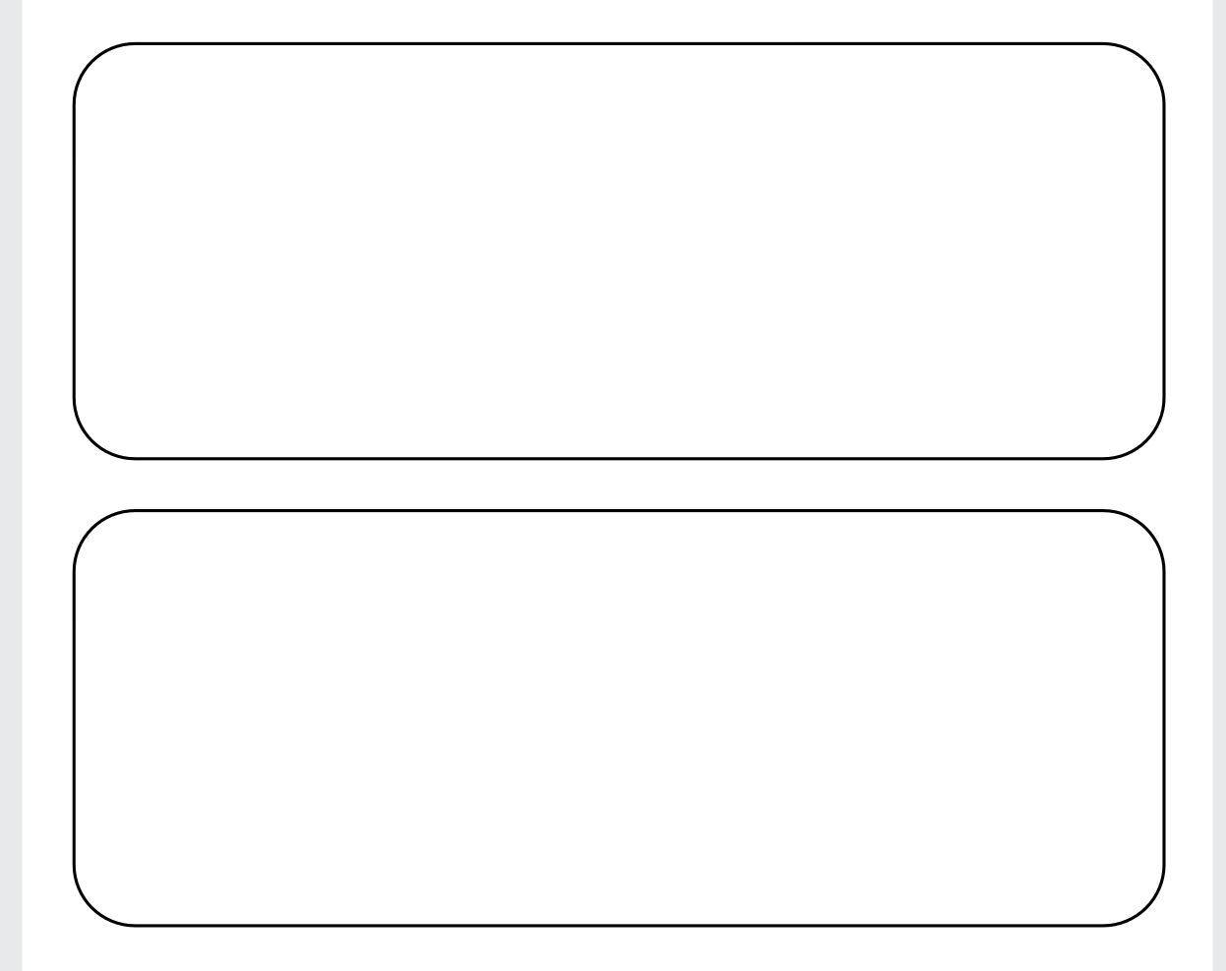
10.1 Case Practice (II)
Step15. Select the two rectangles, change the single corners 20, 20, 20, 20, and hide the path, like the photo.

Slide 20
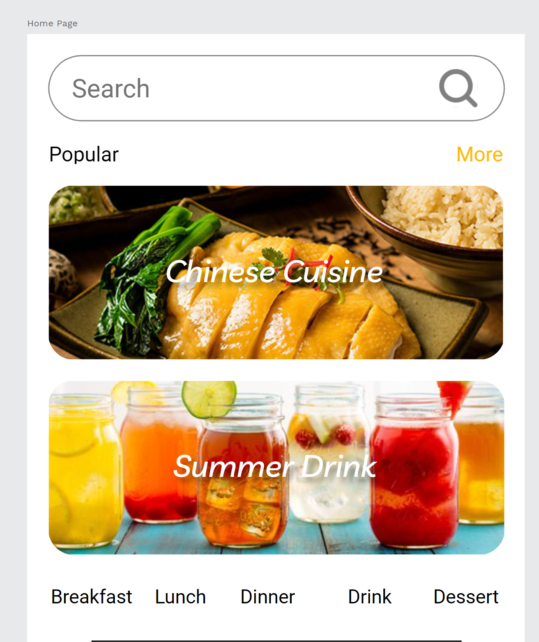
10.1 Case Practice (II)
Step16. Input the two food images in the rectangles, use the mask tool to put the images inside the rectangles.
Scales the images to the right size.
Adding Chinese cuisine and summer drink text on the photos.
Texts color choose white and give the shadow effect.

Slide 21
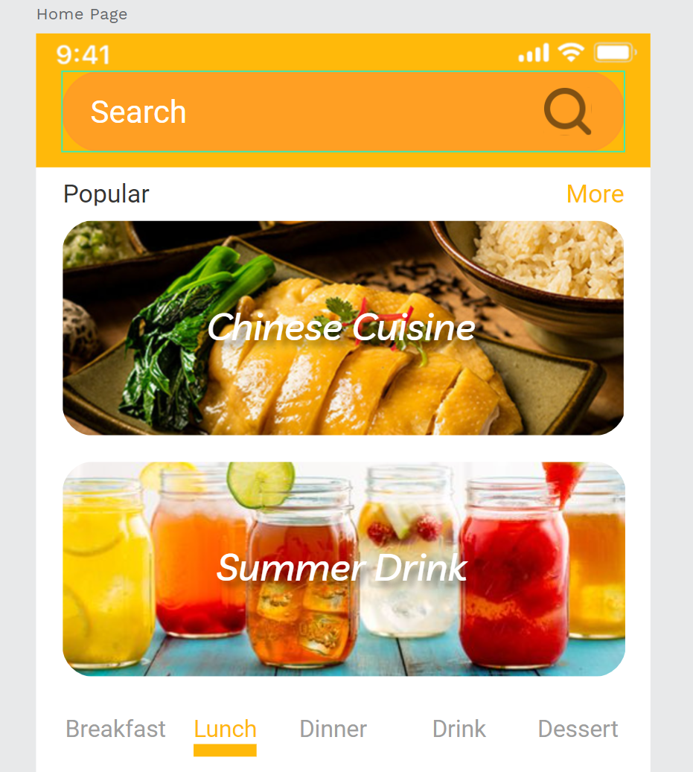
10.1 Case Practice (II)
Step17. Create a new rectangle under the search bar, give it an orange color.
Use the iPhone UI design drag it to the top, change the text, and the search bar color darker orange color.

Slide 22
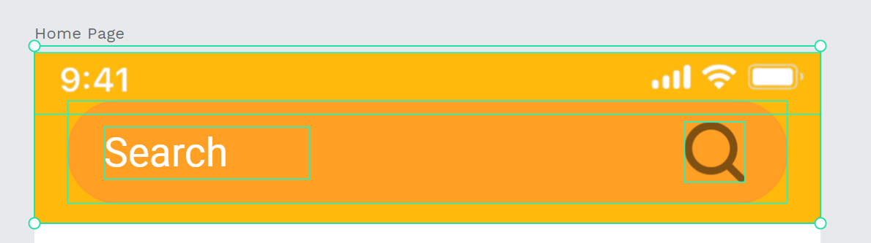
10.1 Case Practice (II)
Step18. Select all the search objects and right-click to create a component.
Because the other page will use it, making a component will reduce the time we need to adjust.

Slide 23
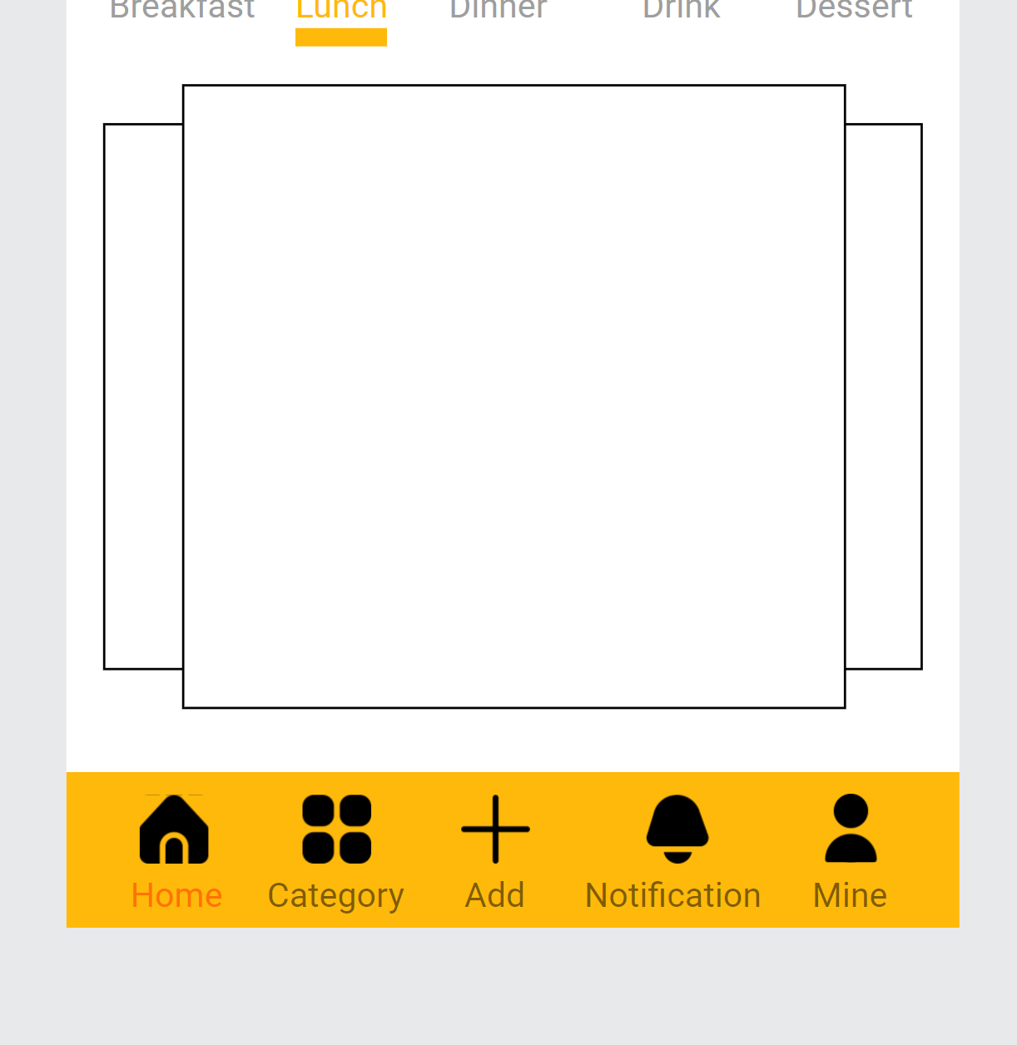
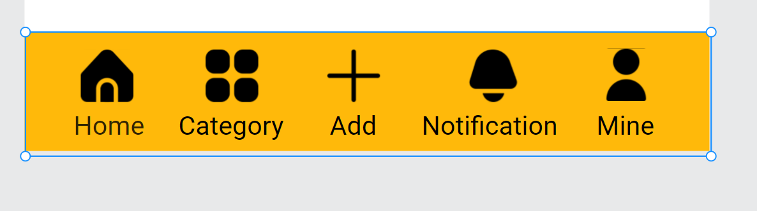
10.1 Case Practice (II)
Step19. Select the icons to drag them in the correct text position.
Adjust the position and size of the icon and text.
Select all the icons and text to create a component for next page to use.

Slide 24
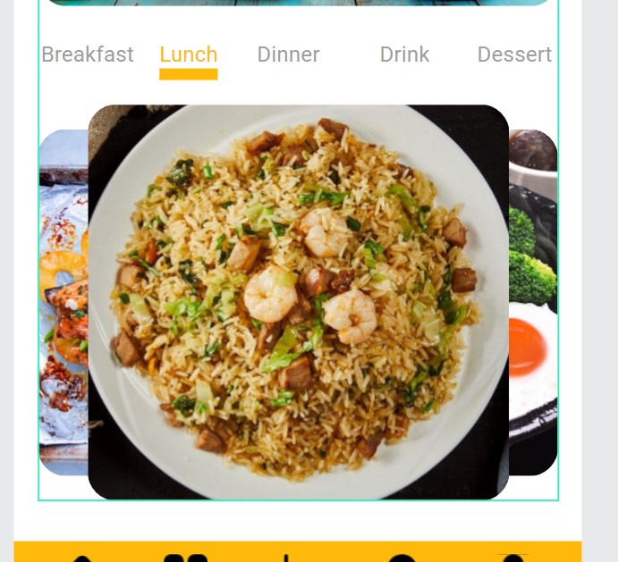
10.1 Case Practice (II)
Step20. Select the images and use the mask tool to mask the images inside the rectangles, remember to change the single corners to 20, 20, 20, 20.

Slide 25
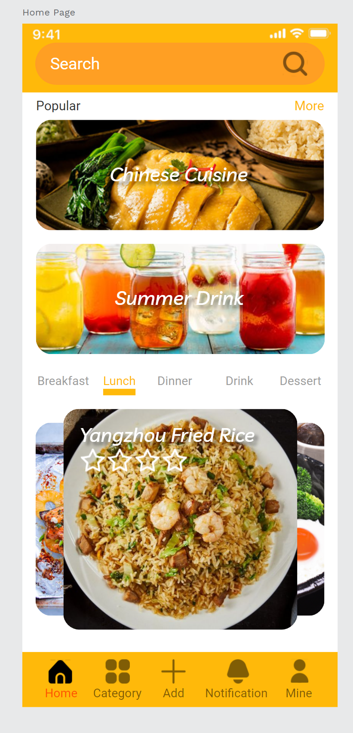
10.1 Case Practice (II)
Step21. Give the name to the image, for example, the picture of the food is Yangzhou fried rice, and give the star icon to the food recipe.
Fine tune the icons and text opacity, to 50%, because is the home page, so the home icon and text don’t need to change.

Slide 26
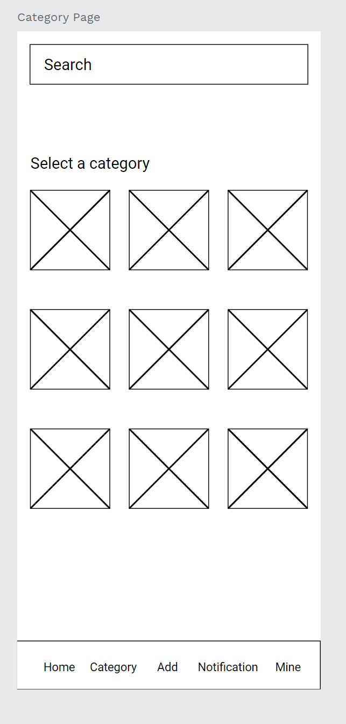
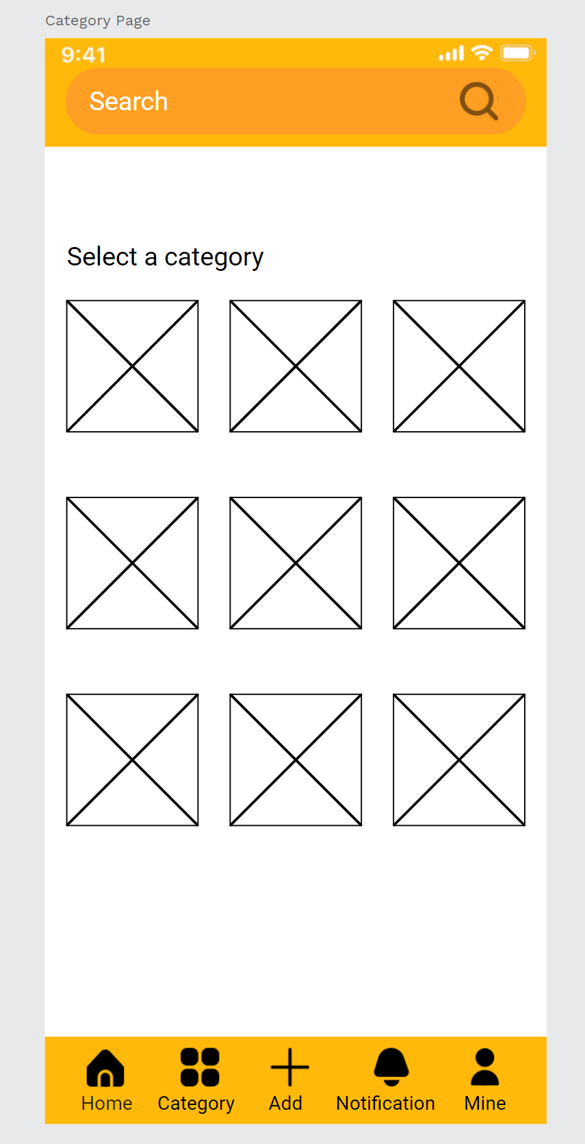
10.1 Case Practice (II)
Step22. In the same step, copy the category page from the Wireframe page to the recipe page.
Use the components like the first few pages to replace the search bar and information bar.

Slide 27
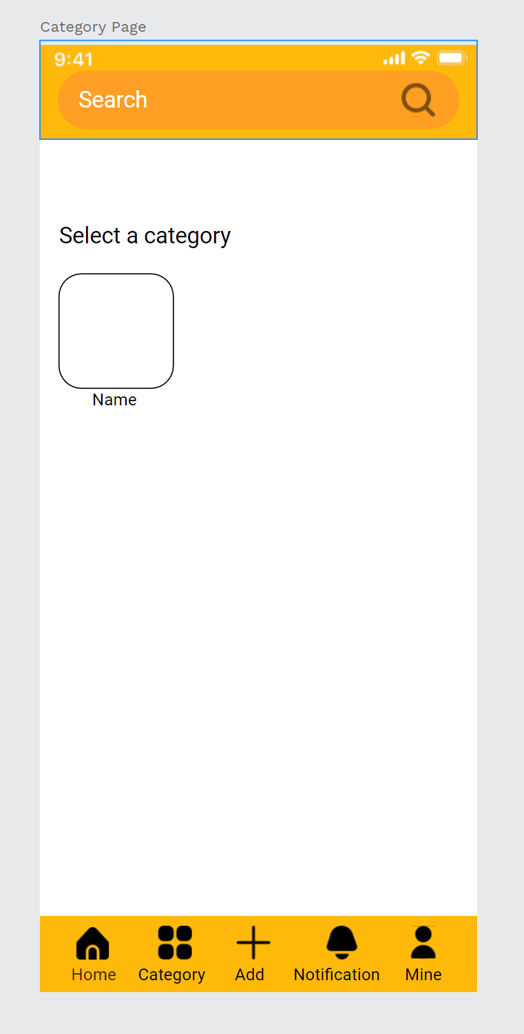
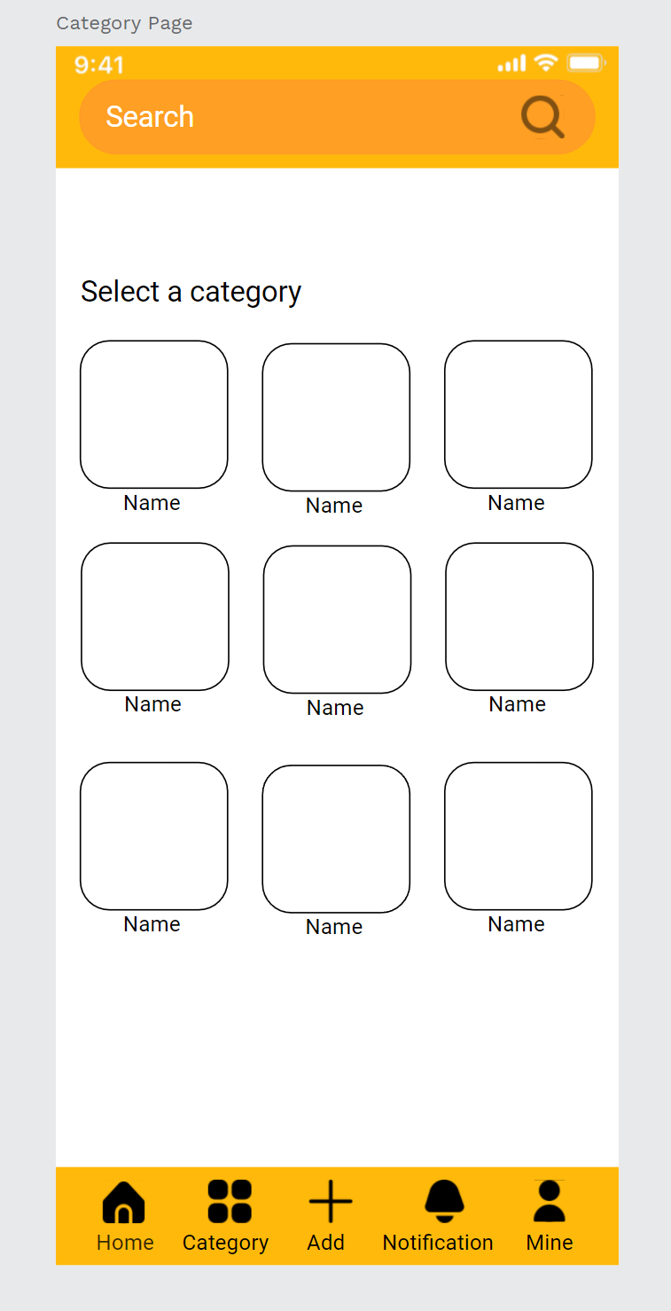
10.1 Case Practice (II)
Step23. Edit the components like the photos, then copy the other like the right-side photos.

Slide 28
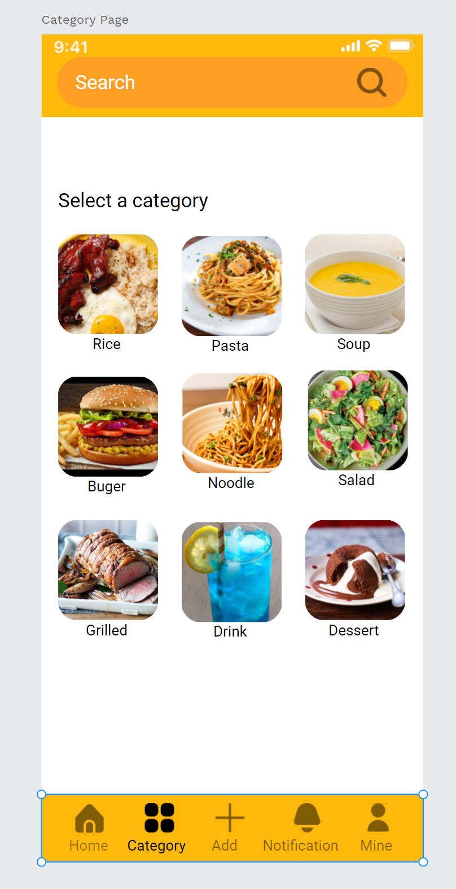
10.1 Case Practice (II)
Step24. input the images and use the mask tool to mask them to each square, and enter the correct name for each food .

Slide 29
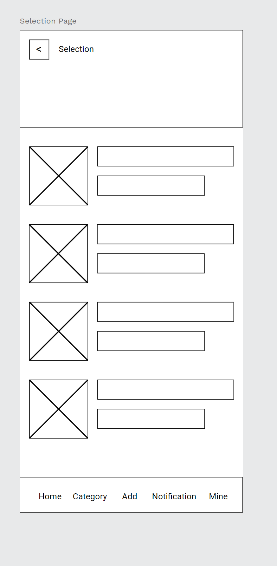
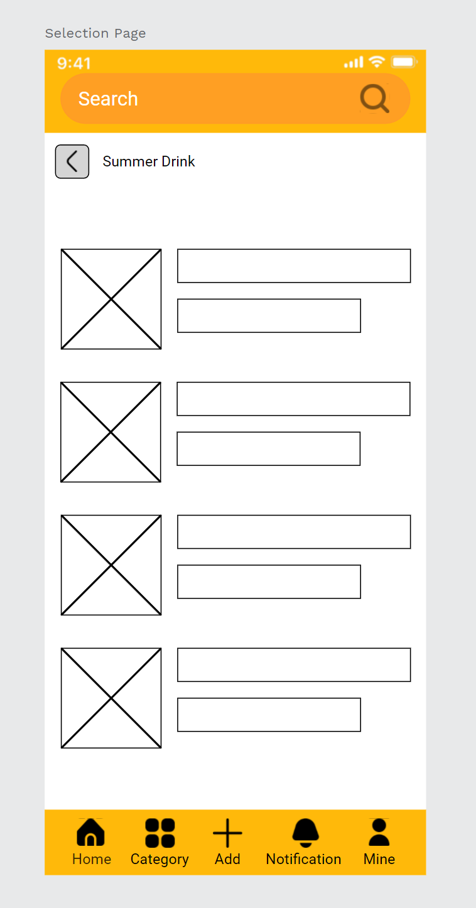
10.1 Case Practice (II)
Step25. In the same step, copy the selection page from the Wireframe page to the recipe page.
Use the components like the first few pages to replace the search bar and information bar.
Change the selected text to summer drink and adjust the position.

Slide 30
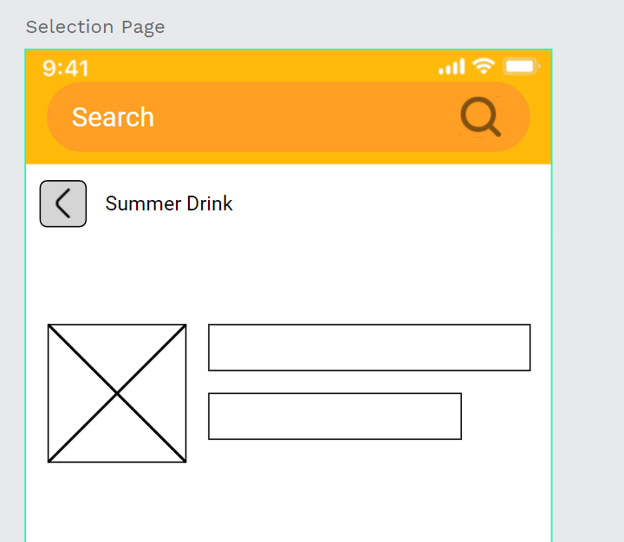
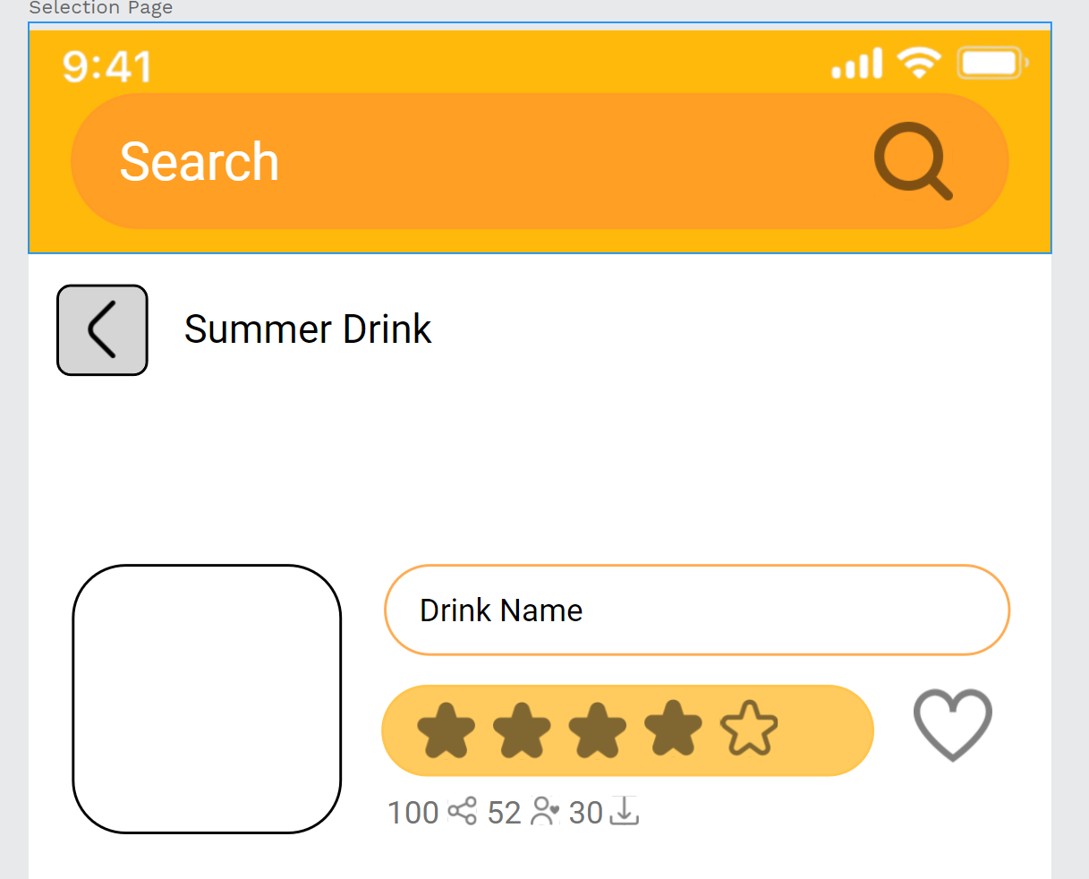
10.1 Case Practice (II)
Step26. Edit the summer drink item component, change the single corners for every rectangle and use the star icon, heart icon, and input the text about the share icon, user favorite icon, and download icon, and use numbers to represent quantities.

Slide 31
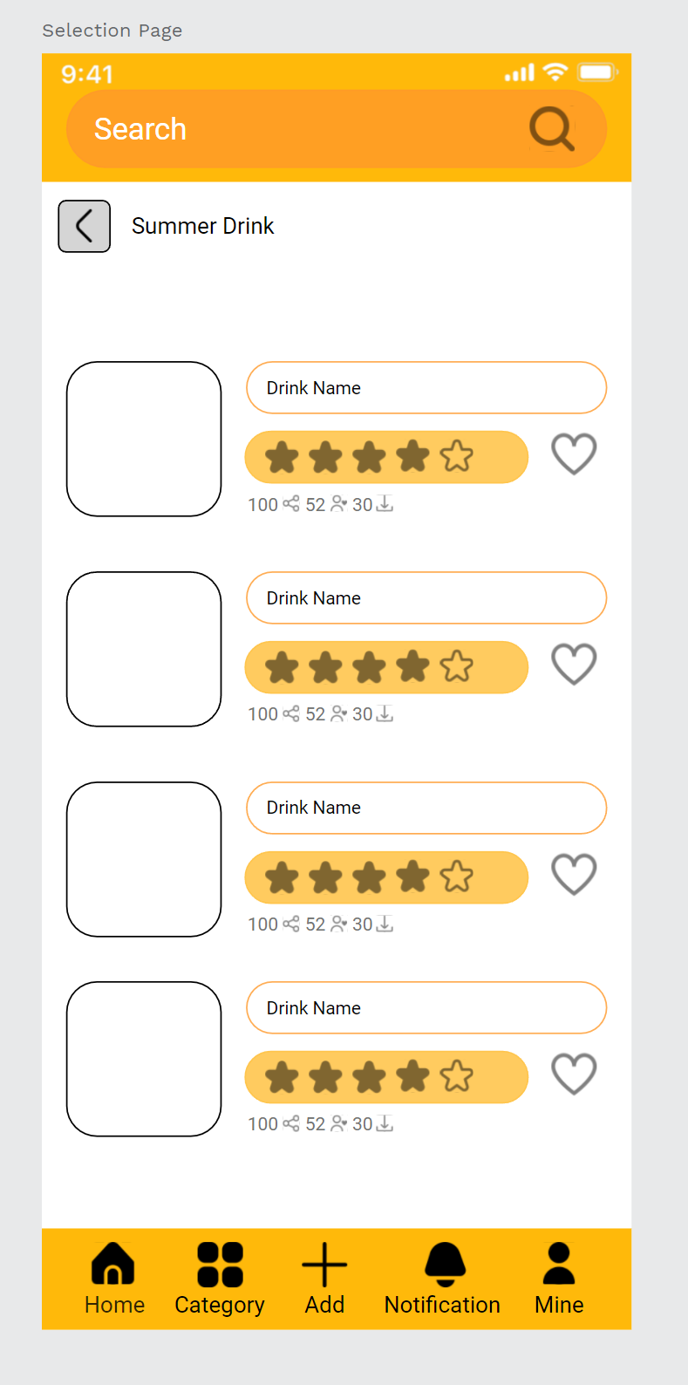
10.1 Case Practice (II)
Step27. After the edited the component, copy and paste the other then adjust the position.

Slide 32
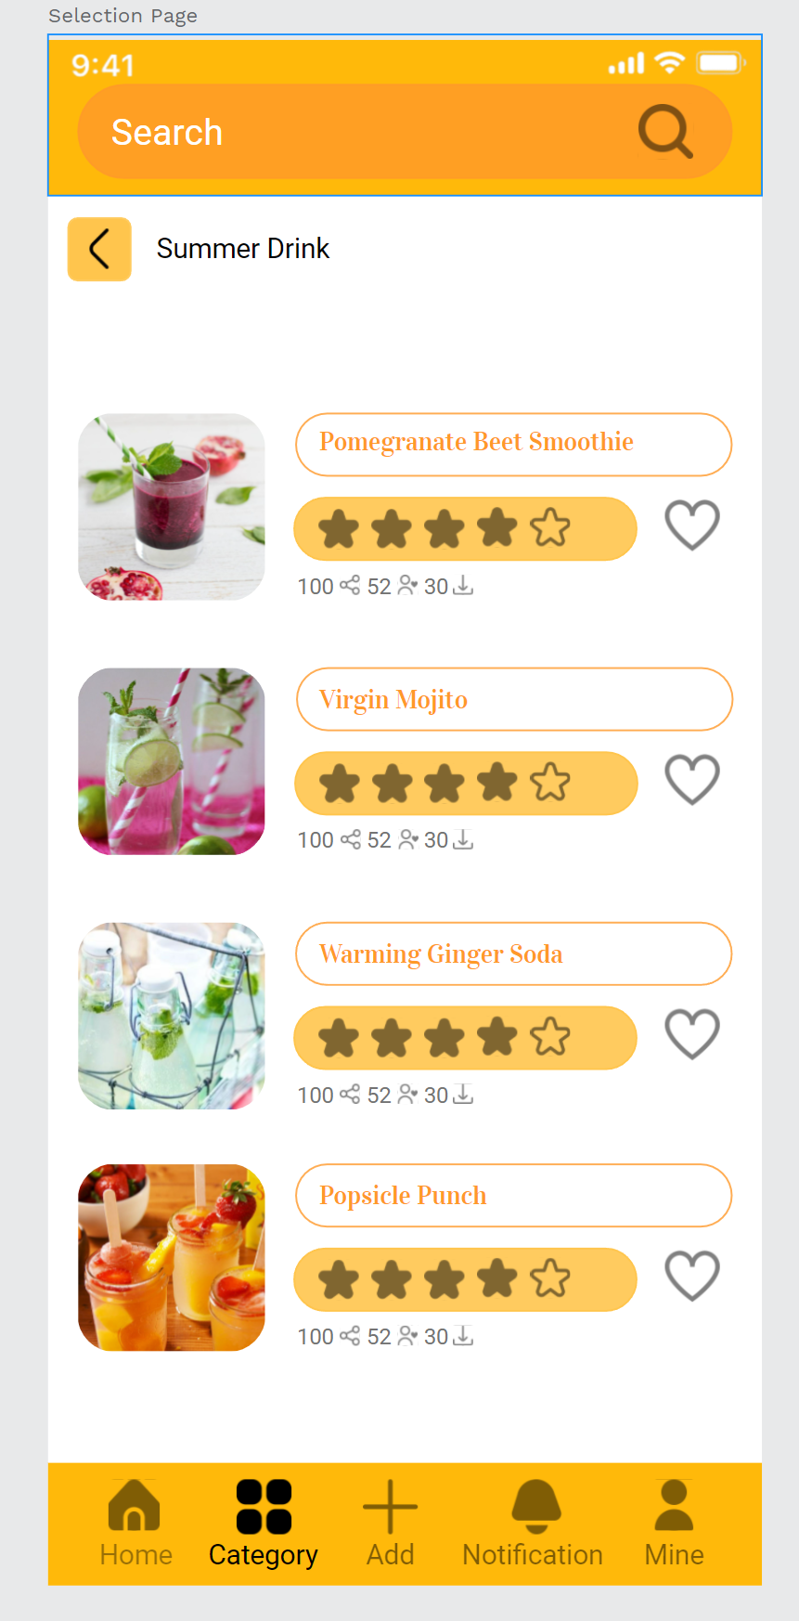
10.1 Case Practice (II)
Step28. Input the summer drink images to each rectangle, enter each summer drink name into the rectangle name bar.
Change the summer drink name text to a different font, can find some summer style font, and choose the color same as the search bar.

Slide 33
10.1 Case Practice (II)
Step29. After inputting all the images and entering the text, check the typography and the text isn't correct then adjust the position.

Slide 34
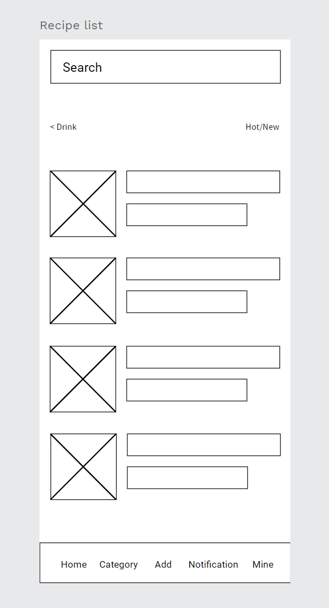
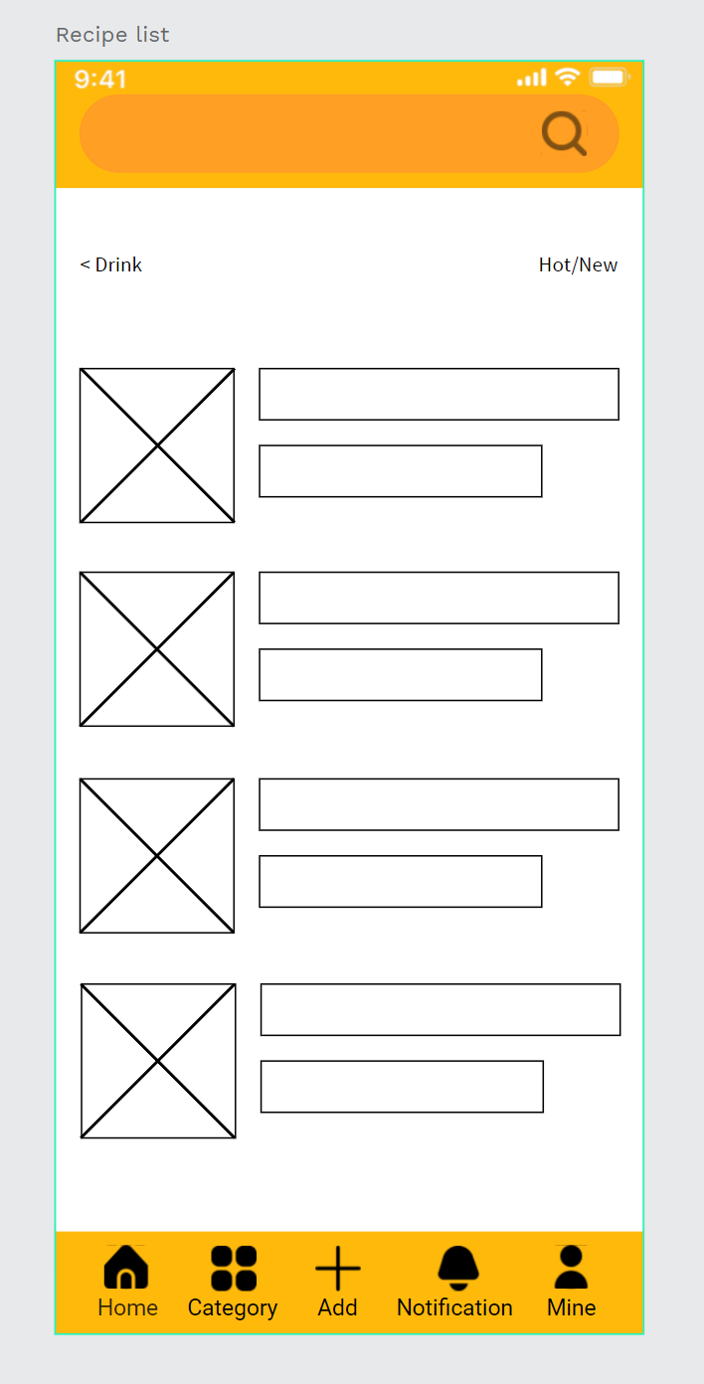
10.1 Case Practice (II)
Step30. the same step with the selection page, copy the Recipe list page from the Wireframe page to the recipe app page.
Use the components like the first few pages to replace the search bar and information bar.

Slide 35
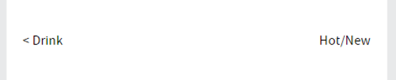
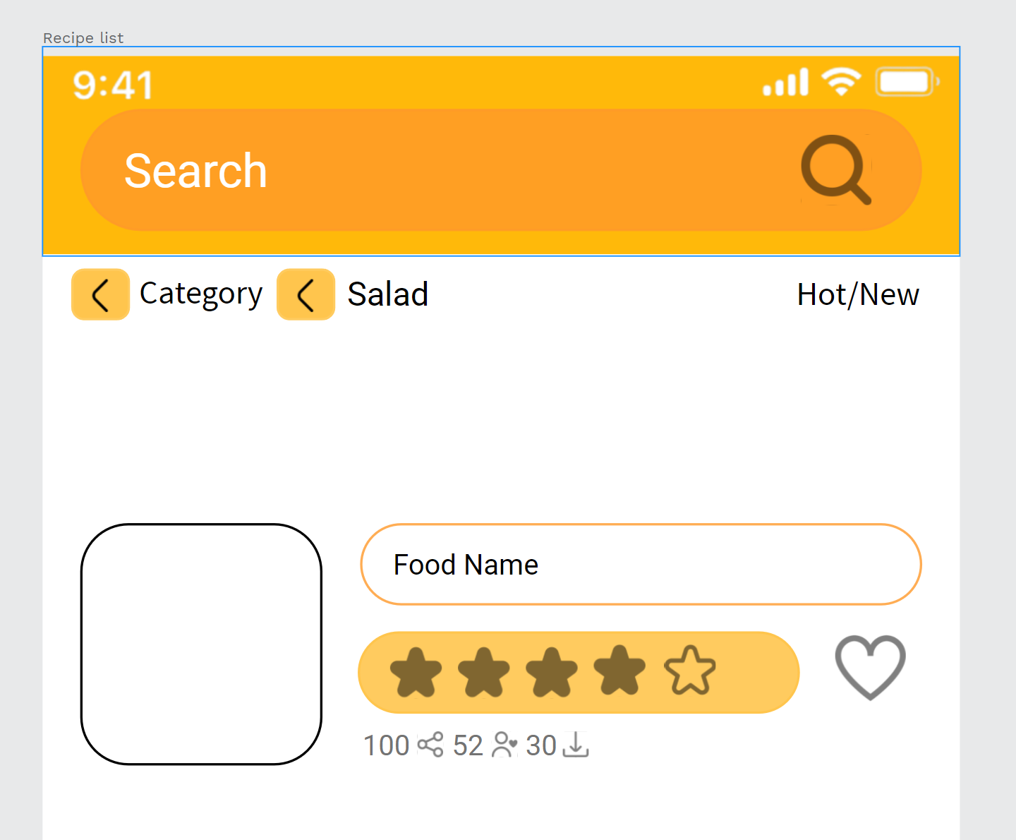
10.1 Case Practice (II)
Step31. Edit the Drink tex to < Category < Salad,
Use the summer drink list component and edit the text to the food name.
Adjust the component to the correct position.

Slide 36
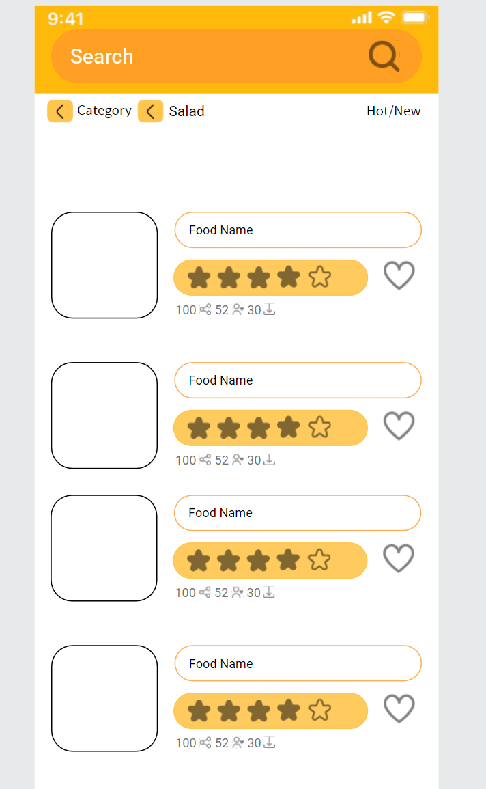
10.1 Case Practice (II)
Step32. After the edited the component, copy and paste the other then adjust the position.

Slide 37
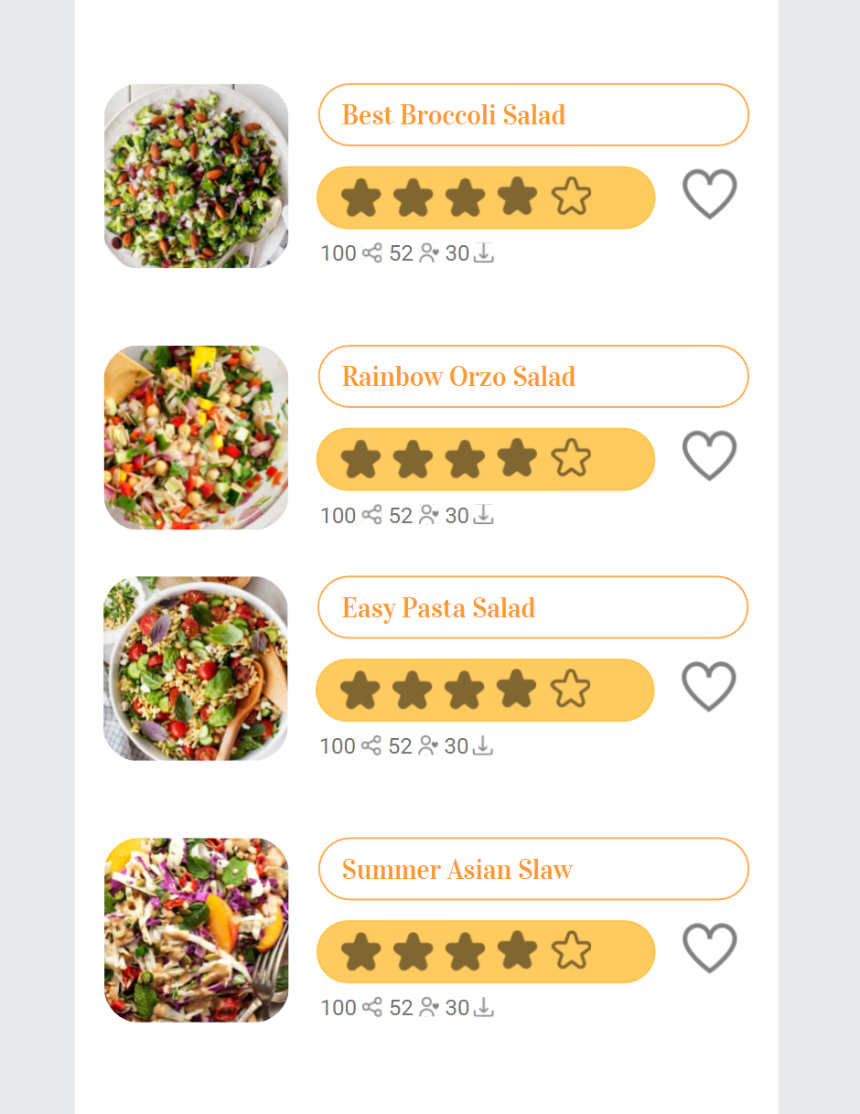
10.1 Case Practice (II)
Step33. Input the salads images to each rectangle, enter each Salads name into the rectangle name bar.
Change the salad’s name text font like the summer drinks font, and choose the color same as the search bar.

Slide 38
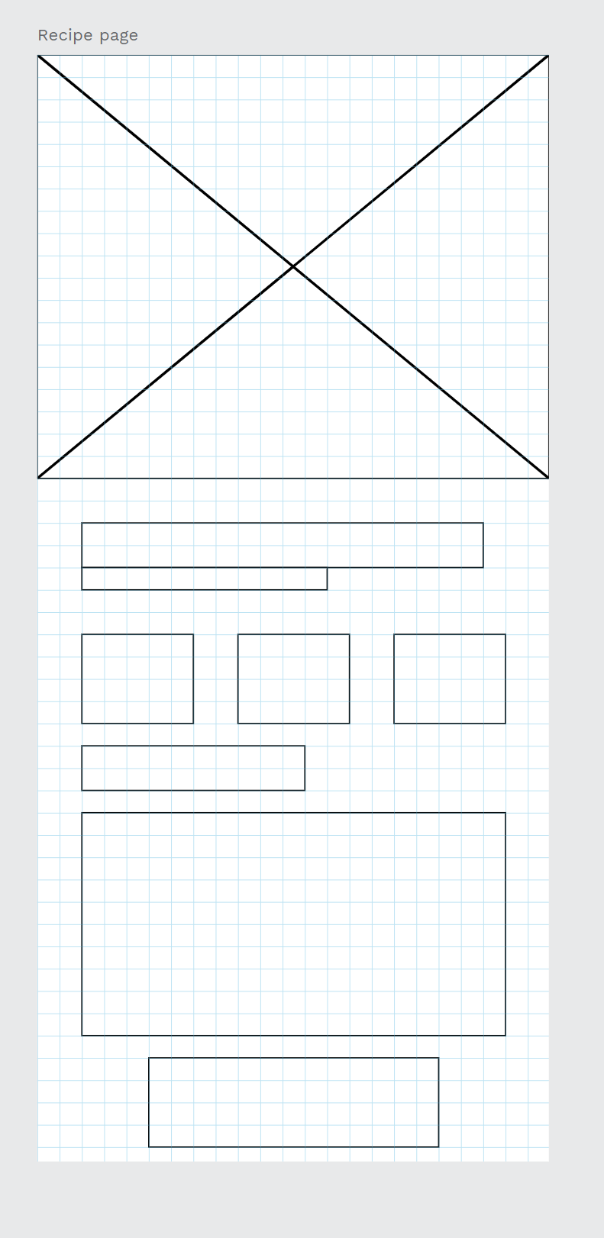
10.1 Case Practice (II)
Step34. The previous lesson mentioned recipe page contents, like the right-side.
We create this page from top to bottom.
Photo
Food name and recipe author
Calories
Total Time
About the Recipe
ingredient
Content
Cook Button

Slide 39
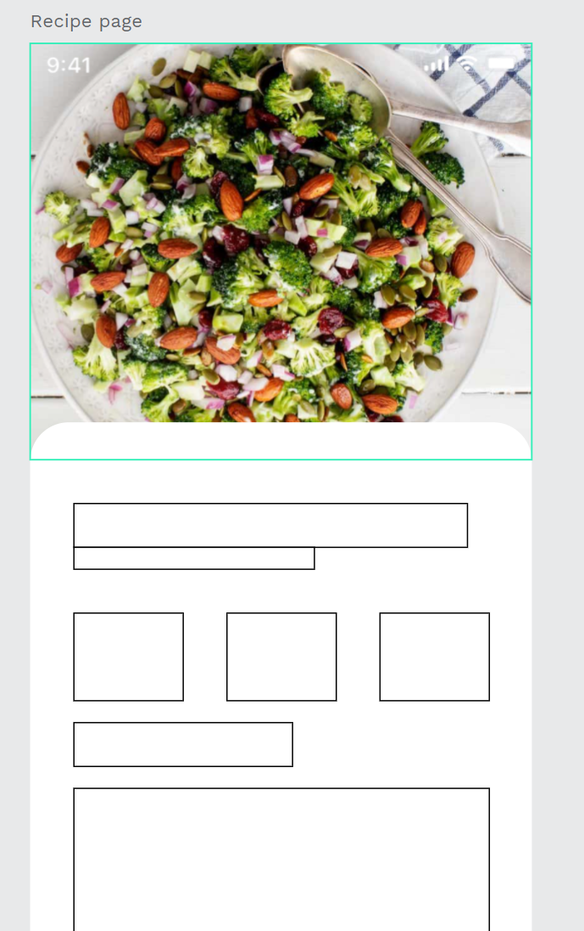
10.1 Case Practice (II)
Step35. We input the photo first and mask it on the rectangle.
Adding the iPhone UI material image, drag the image to the top position.
the white rectangle change the single corners to 20,20, 0, 0.

Slide 40
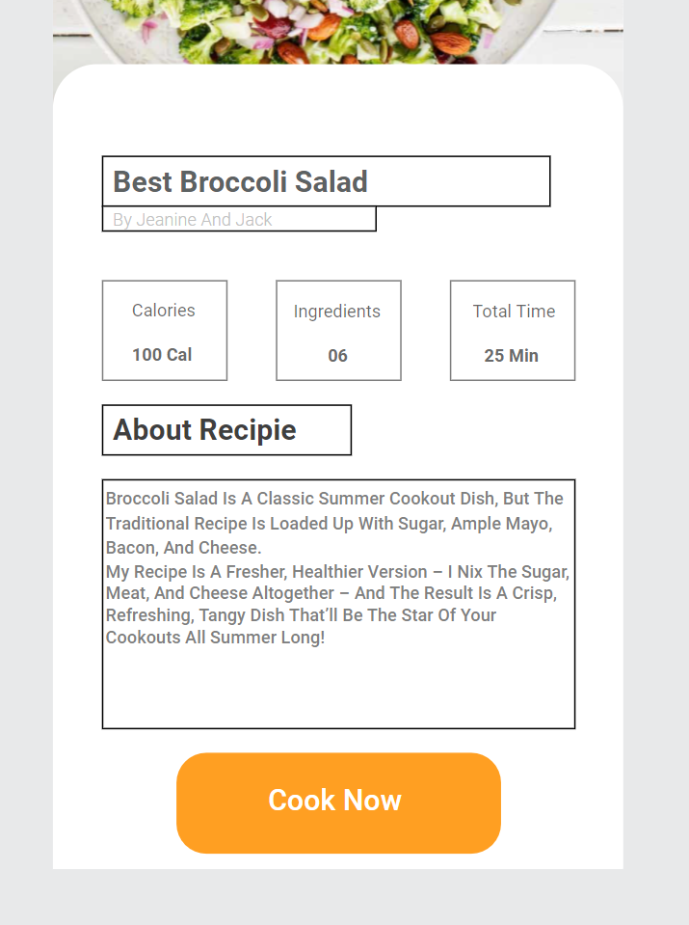
10.1 Case Practice (II)
According to the position of the square, enter the corresponding text.
Food name, recipe author, calories, ingredient, total time, about the recipe, content, and Cook Button.
Remember to change the text to dark gray and light gray, important content is dark gray text, and sub-content is light gray text.

Slide 41
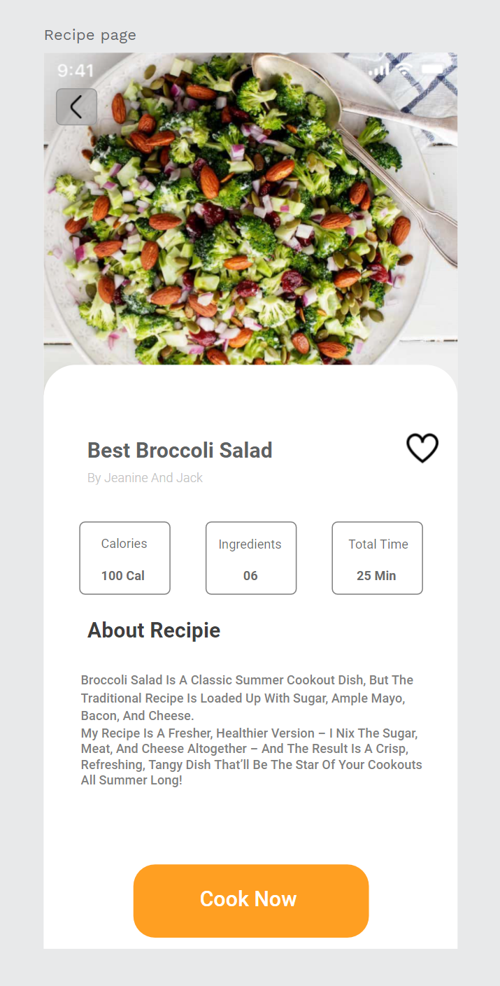
10.1 Case Practice (II)
When you have finished entering all the text, adjust the color and layout, hide and delete unnecessary borders.
Adding the heart icon, and the previous button for the prototype using.

Slide 42
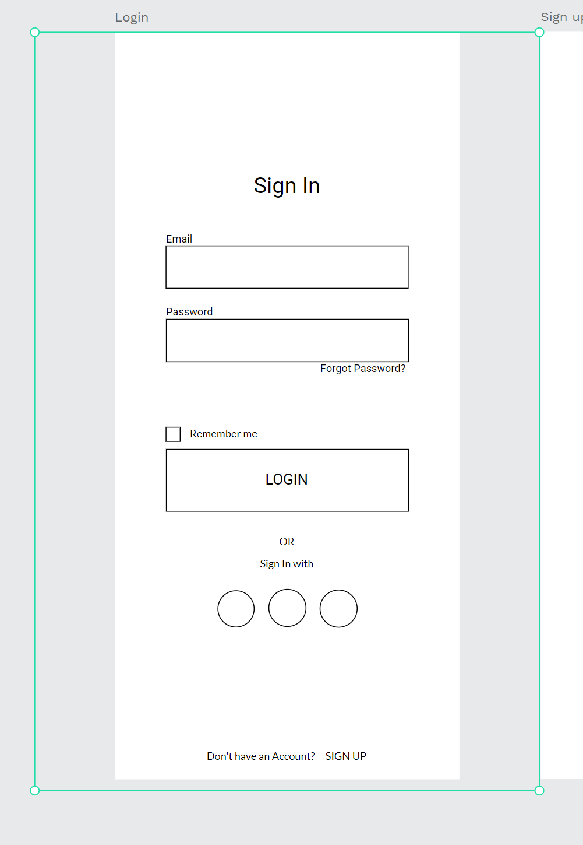
10.1 Case Practice (II)
Now the remaining login page, registration page, and profile page UI design.
Copy the sign-up page from the wireframe page as before we edit the UI design.

Slide 43
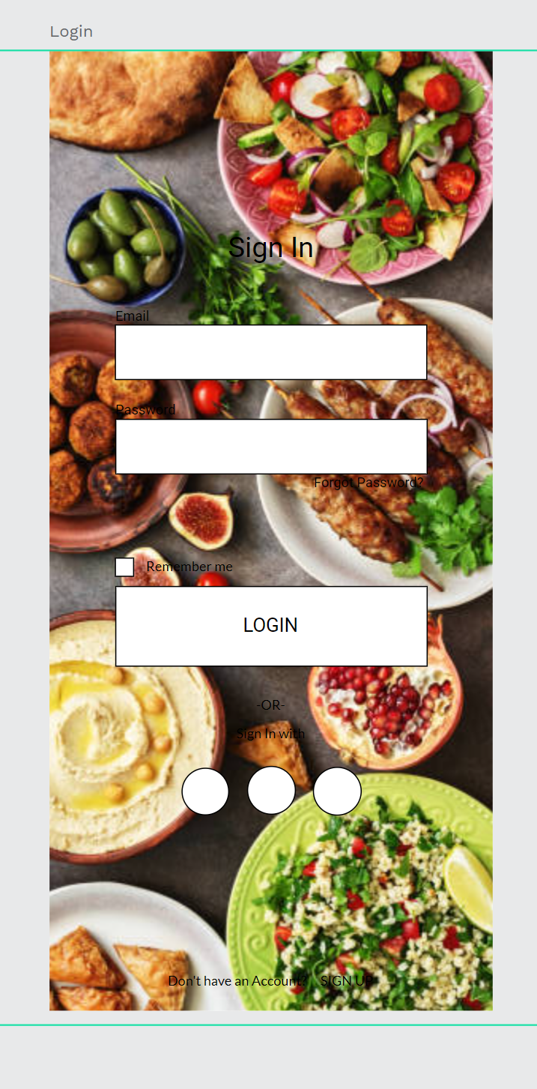
10.1 Case Practice (II)
Copy the landing page background images and paste them on the sign-in page, and put them in layers bottom.

Slide 44
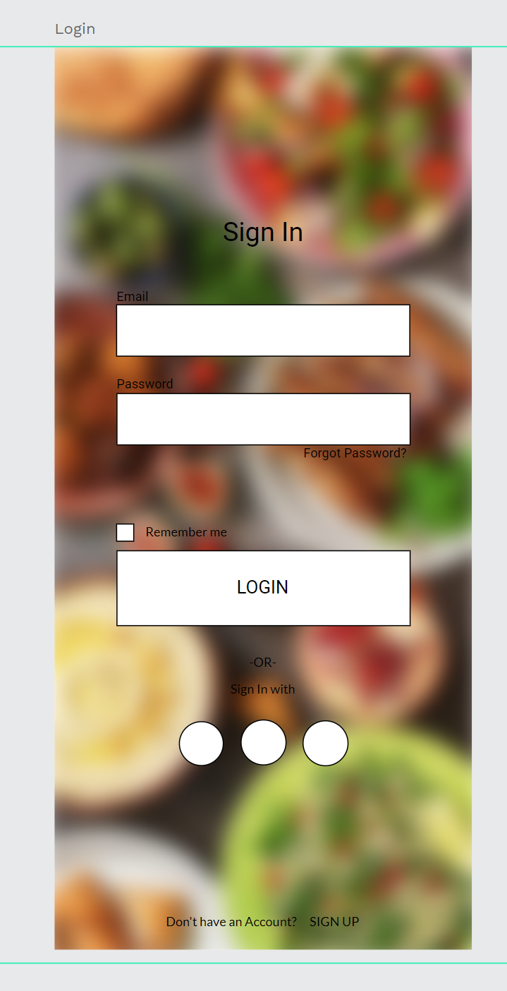

10.1 Case Practice (II)
Select the background images, and add the blur effect.
Setting the blur effect value to 10 px, make the blur effect stronger.

Slide 45

10.1 Case Practice (II)
Change all the text to white color, give the text-shadow effect, and change the shadow effect value shadow color to 50 %.

Slide 46

10.1 Case Practice (II)
Edit the email, password, login rectangle bar, single corners, and hide or delete the stroke effect.
Only the login button has an orange color and a shadow effect.

Slide 47

10.1 Case Practice (II)
Input the Facebook, Google, Twitter icons into the artboard.
Use the mask tool to mask each circle object.

Slide 48

10.1 Case Practice (II)
At last, Select the selection page return
button, copy and paste on the login page, and change the button color to grey color and opacity.

Slide 49

10.1 Case Practice (II)
The same as the initial processing method of the login screen, a complex background image is placed at the bottom of the layer of the sign-up page, and a blur effect is given to it.
Blur effect value set to 10 px.

Slide 50

10.1 Case Practice (II)
Change the text to white color and give it a shadow effect.

Slide 51

10.1 Case Practice (II)
Modify all rectangles to single corners 10,10,10,10, and modify the REGISTER button to orange color given its shadow effect and single corners 20,20,20,20.
Select the selection page return button
Copy and paste on the Signup page, and change the button color to grey color and opacity.

Slide 52

10.1 Case Practice (II)
Finally we go to handle the UI design of the profile page.
Copy the profile page from the wireframe page and paste it to the recipe app page.

Slide 53


10.1 Case Practice (II)
Create a circle object, scale the circle more biggest, and drag it to the top, only show the circle half part, and put the circle in the layer bottom.
Change the profile circle stroke color change to grey color.

Slide 54

10.1 Case Practice (II)
Use the mask tool to mask the profile photo inside the circle.

Slide 55


10.1 Case Practice (II)
Change the text color to grey color.
Copy the icon material paste it on the text left side.
Modify the edit file button color to orange. Single corners 10,10,10,10.
Change the edit file text color to white color.

Slide 56

10.1 Case Practice (II)
Select the selection page return button
Copy and paste on the profile page, and change the button color to grey color and opacity.

Slide 57
Case Practice (III)
10.2

Slide 58

10.2 Case Practice (III)
Now that we have a basic UI/UX design, it's time to do the prototyping interactive, linking the different pages together.

Slide 59

10.2 Case Practice (III)
Step1. Select the Resister and sign-in button including the text, connect to the login page, and sign-up page.

Slide 60

10.2 Case Practice (III)
Step2. To maintain the user experience, the animation effects we choose when dealing with prototype connections are as consistent as possible.
In this case, We can choose to use the trigger is on-click, for detailed settings can see the settings on the right photo.

Slide 61



10.2 Case Practice (III)
Step3. Choose the login page return button and sign-up page return button.
Give the on-click triggers and connect to a landing page.

Slide 62

10.2 Case Practice (III)
Step4. There should be a sentence at the bottom of both pages to prompt if the user does not have an account and how to use it if he has an account.
Select two sentences to connect them to the corresponding page and give the prototype setting

Slide 63


10.2 Case Practice (III)
Step5. Select the Login and Register buttons to connect them both to the main page, representing successful login and registration to the recipe app.

Slide 64

10.2 Case Practice (III)
Step6. Because we have a selection page for summer drinks, we already have a selection button about summer drinks on the home page, so our button for selecting summer drinks includes text that links to the selection page.

Slide 65

10.2 Case Practice (III)
Step7. Select the back button in the upper left corner of the selection page.
Give it trigger On click and action is the previous screen to go back to the previous screen.

Slide 66


10.2 Case Practice (III)
Step8. The category page doesn't have the return button, so if we want to go back to the home page, we have to select the home icon and text to connect it back to the return home page.

Slide 67


10.2 Case Practice (III)
Step9. If we want to go from the home page to the category page, we also have to select the category icon and text of the home page to link to the category page.

Slide 68


10.2 Case Practice (III)
Step10. Select a category's salad icon and text to connect to the recipe list.

Slide 69


10.2 Case Practice (III)
Step11. On the recipe page, we want to know the details of the recipe, we select the part of the recipe item and connect it to the recipe page.

Slide 70

10.2 Case Practice (III)
Step12. Also, recipes will have a button to go back to the page, so we'll select that button and give it a trigger On click and action is the previous screen.

Slide 71


10.2 Case Practice (III)
Step13. Finally, if we want to view a profile page, we can select the Mine icon and text at the bottom of the home page to link it to the profile page.
The same page also has a back button, which is also given to the button a trigger On click and action is the previous screen.

Slide 72
Final Project
10.3

Slide 73
10.3 Final Project
Now you are a UI/UX designer, you have to create a brand new mobile app.
You can apply the same flow to this final set according to the recipe-creating app's process.
Create a prototype mobile app of about 5-6 pages.
(including the wireframe, UI design, and prototype)
Doesn't limit the categories of mobile apps you want to create.
After completion, the output needs to be given to the teacher.

Slide 74
10.3 Final Project
Tips for the final project
First think about the theme of the mobile application you want to make.
Drawing the basic wireframe, and creating in penpot, will increase your later creation speed.
Gather relevant information and reference and may make available photos, the number of photos can be prepared more.
Remember to use color matching and typography techniques to match your phone's UI design.
Exchange ideas with classmates to get more inspiration.

Slide 75
Reference
Reference1 : https://www.youtube.com/watch?v=fGvu1aMpoY4&ab_channel=XuanZhang

